Slide 1

ANNUAL
REPORT
2018-19
PLACEMENT CELL
Submitted by
Prof. R. R. Patil

Slide 2
ANNUAL REPORT: PLACEMENT CELL-2018-19
INDEX
Sr. No. | Particular | No. of students | Page no.
1. | Introduction about Placement cell | -- | 3
2 | Israel Training | 07 | 4
3 | Students Selected For Post Graduation | 08 | 5
4 | Selection in MPSC | 06 | 6-7
5 | Banking Sector | 04 | 8
6 | Avishkar | 01 | 9-10

Slide 3
ANNUAL REPORT: PLACEMENT CELL-2018-19
INTRODUCTION
ABOUT PLACEMENT CELL
The placement cell was established in the Academic year 2011-12 with the aim to develop the employability, Skill of presentation and communication, enrich the students with current affairs and status of industries, and encourage the students for the various competitive examinations.
The team of 10 students from final year work under the guidance of the placement officer Prof. R. R .Patil for organizing the lectures of the Industrial Experts, successful entrepreneurs, Ex-students who have been qualified in the competitive examinations. Approaching the various agriculture related Manufacturing, Processing, Marketing, Research and Finance companies/Industries, Communication with them for recruitment of students and Organizing vocational seminars about the suitability of the students for the various jobs in the company/Industry is achieved through the team of students with the consultation of qualified Faculty members of the college. The Companies are called for the campus interviews in this college and the placement officer with the team of students organizes the Campus Interviews. Sometimes the students are sent for the interviews in the companies for the selection.
Almost all the companies, called for the Campus Interviews are satisfied with the performance of the students from this college and whenever the recruitment comes they call this college on priority.
Also this college is committed to overall growth of students through well planned, graded and tested systems of instruction in disciplined manner with an aim to provide qualified, capable and motivational Agricultural graduate to the rural society.
Placement Officer
Prof. R.R.Patil

Slide 4
ANNUAL REPORT: PLACEMENT CELL-2018-19
Israel training
Sr. No. | Name of students | Reg. No. | Class
1 | Ms. Shaila Shivaji Arabole | AT-2015/003 | T.Y. B.Sc (Agri.)
From the above students was selected for summer programme in Agricultural Sciences – 2019 @ The Hebrew University of Jerusalem, Israel.

Slide 5
ANNUAL REPORT: PLACEMENT CELL-2018-19
Students selected for Post Graduation
Sr. No. | Name of students | Reg. No. | Department | College/University
1 | B. Radha Krishna | AT-2015/06 | Plant Breeding | SHAUTS,UP
2 | Mr.Karande Vaibhav T. | AT-2015/44 | AHDS | PDKV, Akola
3 | M.Shanmukha Reddy | AT-2015/53 | Plant Breeding | SHAUTS,UP
4 | Y.V.Akhil | AT-2015/60 | Plant Breeding | SHAUTS,UP
5 | Ms. Patil Shubhada S. | AT-2015/87 | Agril. Economics | PDKV, Akola
6 | Mr. Salukhe Subham R. | AT-2015/102 | Agril. Biotechology | VNMKV, Parbhani
7 | Mr. Dahiphale Amol Y. | AT-2014/19 | IWM | MPKV, Rahuri
8 | Ms. Desai Swati D. | AT-2014/21 | Agril. Economics | MPKV, Rahuri
Above students were selected for Post gradation conducted by MCAER, Pune for seeking admission to higher study M. Sc (Agri.)

Slide 6
ANNUAL REPORT: PLACEMENT CELL-2018-19
Agriculture officer – Govt. of Maharashtra - 2019-20
Sr. No | Name of students | Designation
1 | Mr. Vaibhav Suresh Dighe | Agriculture Officer
2 | Mr. Umesh Ankush Mohite | Agriculture Officer
3 | Mr. Haridas Bhimrao Bonge | Agriculture Officer
4 | Mr. Sushant Suresh Mane | Taluka Agriculture officer
5 | Ms. Sonali Hanmantrao Sutar | Agriculture Officer
Police Sub Inspector-2019
Sr. No | Name of students | Designation
1 | Ms. Shahin Zakirhusen Desai | Police Sub Inspector
Our Alumni were selected in different Agricultural Department through Agricultural MPSC Examination.

Slide 7
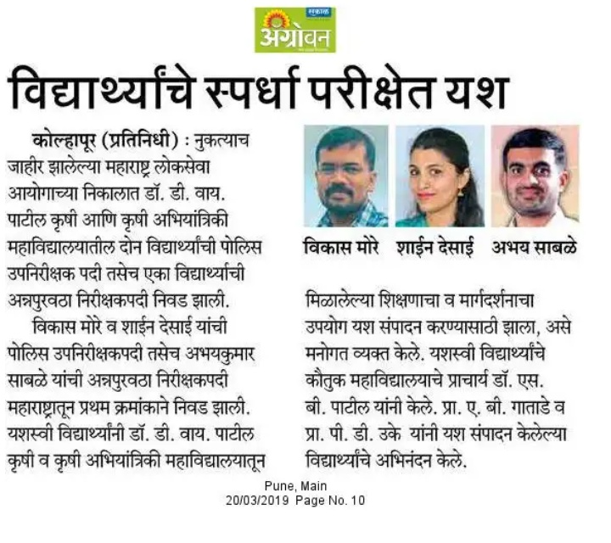
ANNUAL REPORT: PLACEMENT CELL-2018-19

Slide 8
ANNUAL REPORT: PLACEMENT CELL-2018-19
Success of students in Banking (Agricultural field officer)
Sr. No. | Name of Students | Name of Bank
1 | Mr. Shrikant Dattatray Gore | Bank of Baroda
2 | Ms. Priyanka Shashikant Raut | Bank of Baroda
3 | Ms. Anuja Appaso Bhosale | Bank of Baroda
4 | Mr. Sujit Gulabrao Bhosale | Bank of Baroda
Above students were selected in Banking sector in different nationalised banks through IBPS Examination as a Agricultural Field Officer.

Slide 9
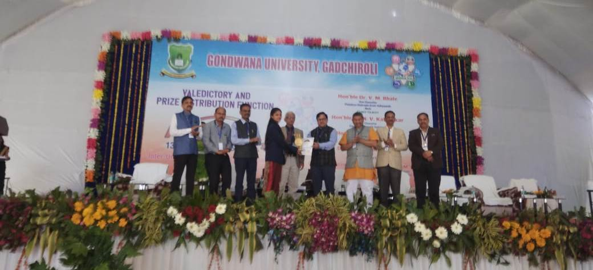
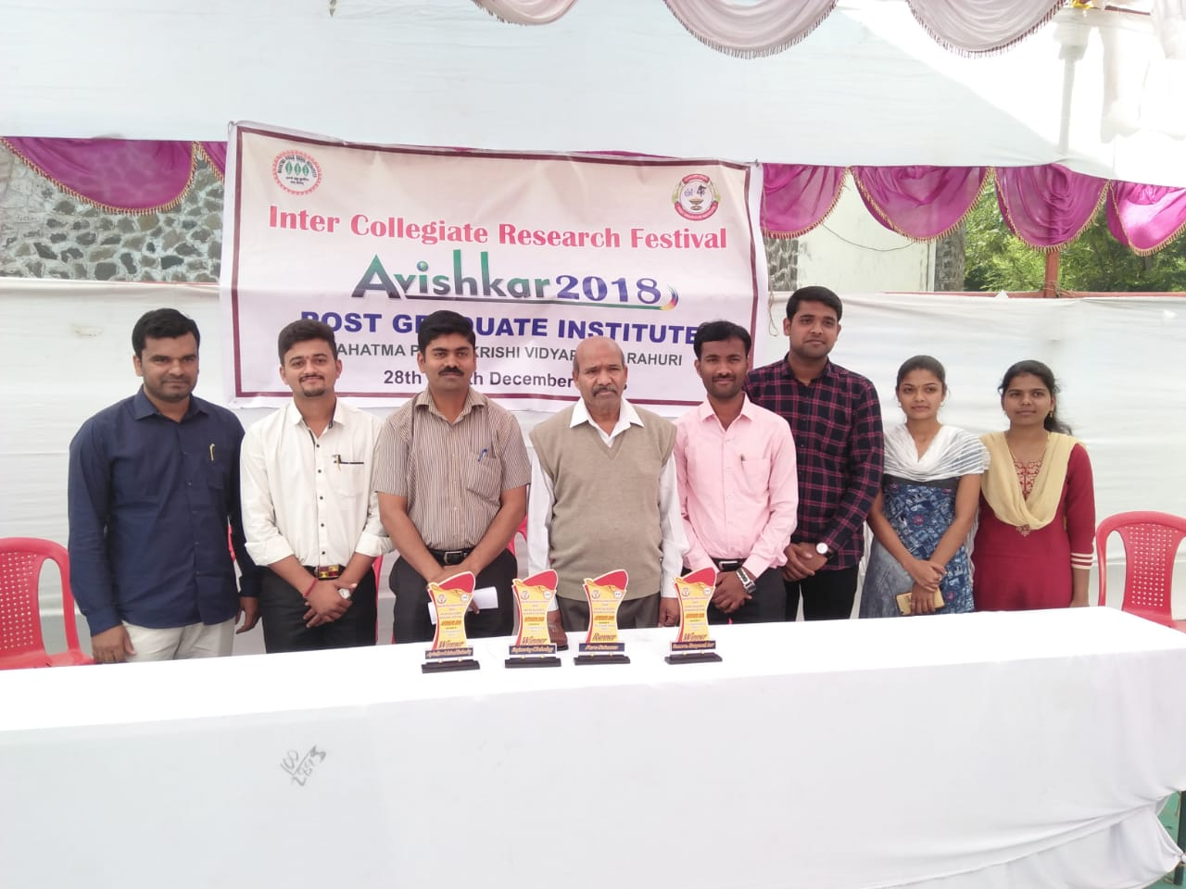
ANNUAL REPORT: PLACEMENT CELL-2018-19
Success in Avishkar –2018
Ms. Snehal Thorat receiving first prize and Awarded with Avishkar Fellowship Rs. 3000/month for 10 months.
Success in ‘Inter Collegiate Research Festival’ Avishkar – 2018
Held at Post Graduate Institute, MPKV., Rahuri
Ms. Snehal Thorat, Ms. Snehal Gawade
with Dr. P. A. Turbatmath, Associate Dean, (PGI) MPKV., Rahuri

Slide 10
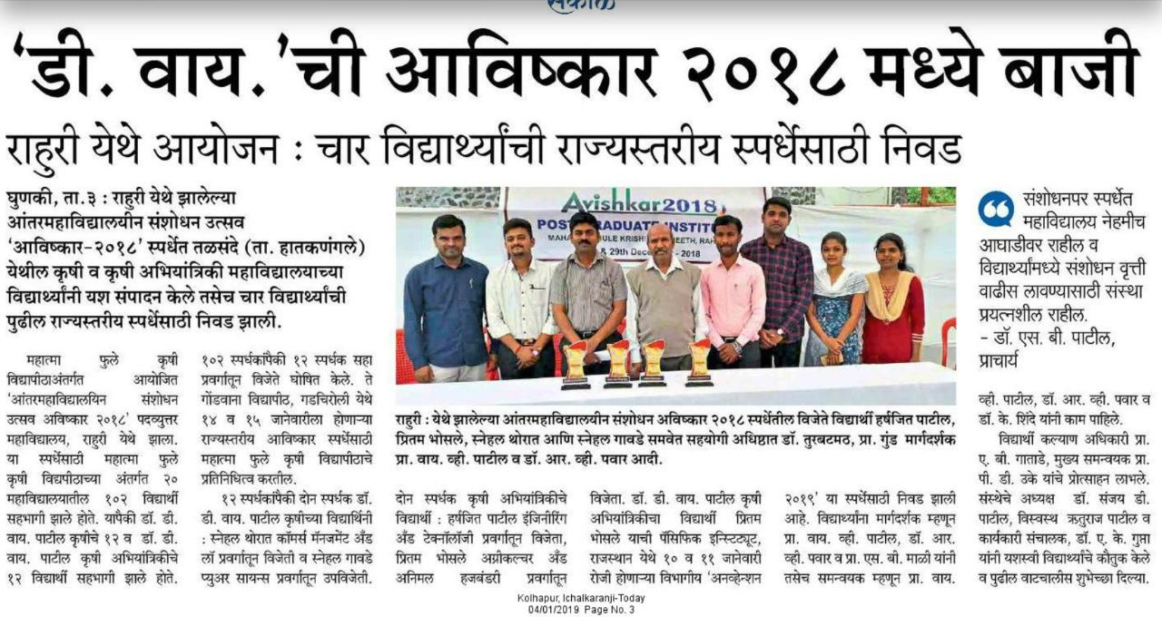
ANNUAL REPORT: PLACEMENT CELL-2018-19

Slide 11
ANNUAL REPORT: PLACEMENT CELL-2018-19
Thank You

