Slide 1

ANNUAL
REPORT
2019-20
PLACEMENT CELL
Submitted by
Prof. R. R. Patil

Slide 2
ANNUAL REPORT: PLACEMENT CELL-2019-20
INDEX
Sr. No. | Particular | No. of students | Page no.
1. | Introduction about Placement cell | -- | 3
2 | Israel Training | 07 | 4-5
3 | Rank in MCAER Exam | 41 | 6-7
4 | Selection in MPSC | 05 | 8
5 | Banking Sector | 04 | 9

Slide 3
ANNUAL REPORT: PLACEMENT CELL-2019-20
INTRODUCTION
ABOUT PLACEMENT CELL
The placement cell was established in the Academic year 2011-12 with the aim to develop the employability, Skill of presentation and communication, enrich the students with current affairs and status of industries, and encourage the students for the various competitive examinations.
The team of 10 students from final year work under the guidance of the placement officer Prof. R. R .Patil for organizing the lectures of the Industrial Experts, successful entrepreneurs, Ex-students who have been qualified in the competitive examinations. Approaching the various agriculture related Manufacturing, Processing, Marketing, Research and Finance companies/Industries, Communication with them for recruitment of students and Organizing vocational seminars about the suitability of the students for the various jobs in the company/Industry is achieved through the team of students with the consultation of qualified Faculty members of the college. The Companies are called for the campus interviews in this college and the placement officer with the team of students organizes the Campus Interviews. Sometimes the students are sent for the interviews in the companies for the selection.
Almost all the companies, called for the Campus Interviews are satisfied with the performance of the students from this college and whenever the recruitment comes they call this college on priority.
Also this college is committed to overall growth of students through well planned, graded and tested systems of instruction in disciplined manner with an aim to provide qualified, capable and motivational Agricultural graduate to the rural society.
Placement Officer
Prof. R.R.Patil

Slide 4
ANNUAL REPORT: PLACEMENT CELL-2019-20
Israel training
The Council of Higher Education, Govt. of Israel offers scholarship of 18,400 N.I. S.(3,57,880 Rs.)
Training Period – 08 July to 07 August 2019
Sr. No. | Name of student | Class
1 | Mr. Sharad Kadam | T. Y. B. Sc. Agri.
2 | Ms. Snehal Gavade
3 | Ms.Shubhangi Powar
4 | Ms.Namrata Mohite
5 | Ms.Poonam Shinde
6 | Ms.Fatima Mulani
7 | Ms.Rohini Kadam
From the above list of students was selected for summer programme in Agricultural Sciences - 2019 at The Hebrew University of Jerusalem, Israel

Slide 5
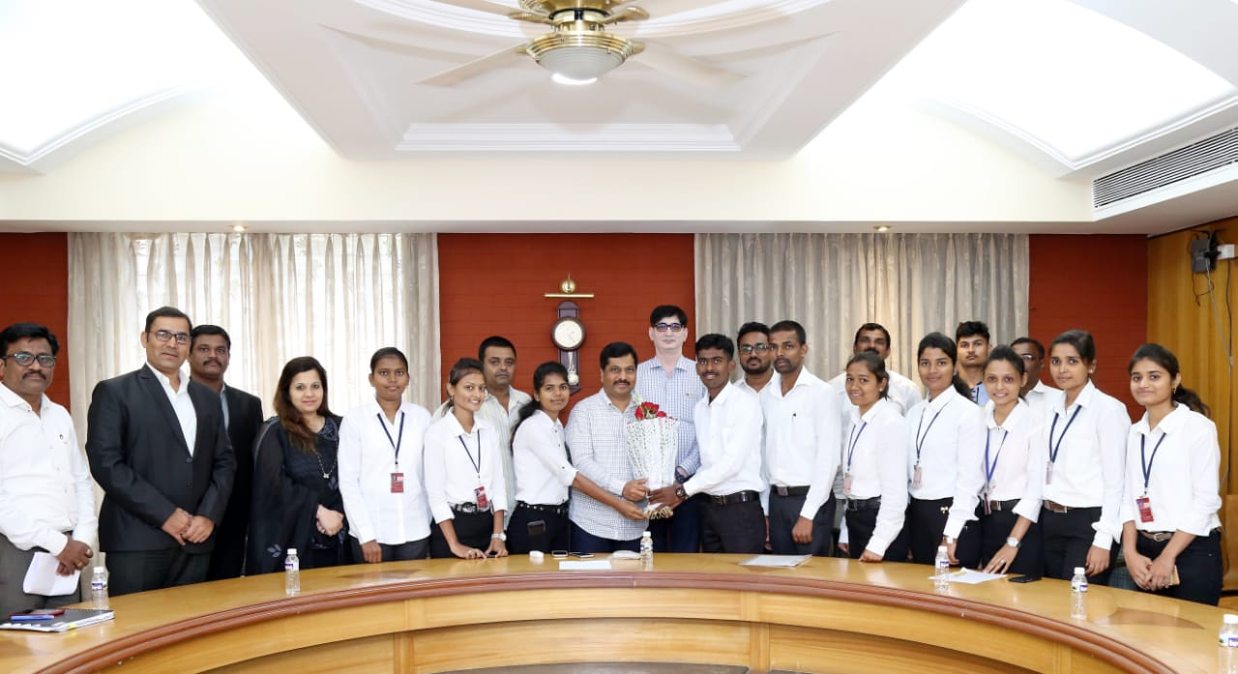
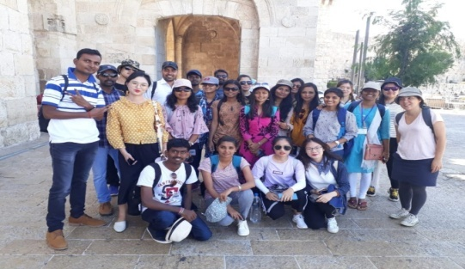
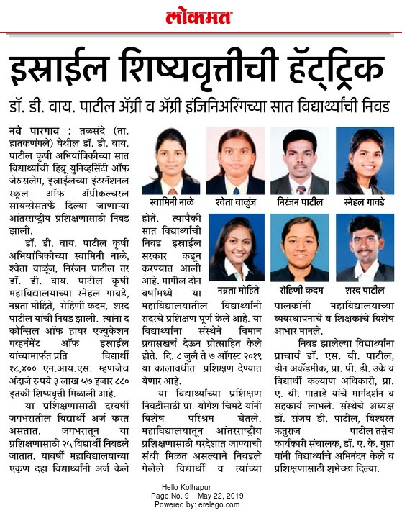
ANNUAL REPORT: PLACEMENT CELL-2019-20
Israel training
Dr. Sanjay D, Patil felicitating students selected for Summer Program in Agricultural Sciences July- August 2019 at The Faculty of Agriculture , Food &b Environment. The International School of Agricultural Sciences, The Hebrew University of Jerusalem, Israel

Slide 6
ANNUAL REPORT: PLACEMENT CELL-2019-20
Students secured rank in MCAER Examination
Stream - Agriculture
Sr. No | Name of Student | MCAER Rank
01. | Vyavhare Swapnil | 05
02 | Kadam Sharad | 07
03 | Barge Ashitosh | 24
04 | Sankeshwari Omkar | 43
05 | Sathe Rishikesh | 70
06 | Beloshe Shubham | 102
07 | Gavade Snehal | 108
08 | Budhawant Pratik | 160
09 | Wadekar Kishor | 187
10 | Powar Shubhangi | 203
11 | Mohite Namrata | 225
12 | Raut Suraj | 238
13 | Chavan Ashish | 289
14 | Jagdale Ranjeetsinh | 294
15 | Gardi Vanita | 339
Sr. No | Name of Student | MCAER Rank
16 | Chandramani Milind | 349
17 | Zange Akash | 354
18 | Shinde Poonam | 372
19 | Ghuge Chameli | 497
20 | Jadhav Anuja | 501
21 | Karande Poonam | 528
22 | Dagade Neha | 540
23 | Nerlekar Amruta | 541
24 | Mulani Fatima | 647
25 | Patil Tejas | 648
26 | Mote Namrata | 711
27 | Kadam Rohini | 753
28 | Jawale Dhiraj | 767
29 | Vanjari Shweta | 960
30 | Mane Chakrapani | 980

Slide 7
ANNUAL REPORT: PLACEMENT CELL-2019-20
Students secured rank in MCAER Examination
Stream - Horticulture
Sr. No | Name of Student | MCAER Rank
01. | Kadam Sharad | 05
02 | Beloshe Shubham | 08
03 | Sankeshwari Omkar | 12
04 | Chandramani Milind | 48
05 | Powar Shubhangi | 63
06 | Chavan Ashish | 69
07 | Zanje Akash | 71
08 | Barge Ashitosh | 90
09 | Vyavhare Swapnil | 92
10 | Sathe Rushiksh | 101
11 | Nerlekar Amruta | 117
Stream - ABM
Sr. No | Name of Student | MCAER Rank
01 | Chandramani Milind | 20

Slide 8
ANNUAL REPORT: PLACEMENT CELL-2019-20
Agriculture officer – Govt. of Maharashtra - 2019-20
Sr. No | Name of students | Designation
1 | Mr. Vaibhav Suresh Dighe | Agriculture Officer
2 | Mr. Umesh Ankush Mohite | Agriculture Officer
3 | Mr. Haridas Bhimrao Bonge | Agriculture Officer
4 | Mr. Sushant Suresh Mane | Taluka Agriculture officer
5 | Ms. Sonali Hanmantrao Sutar | Agriculture Officer
Our Alumni were selected in different Agricultural Department through Agricultural MPSC Examination.

Slide 9
ANNUAL REPORT: PLACEMENT CELL-2019-20
Student Selection in Bank (AFO)
Sr. No. | Name of Students | Bank Name
1 | Ms. Sayali Sadanandh Gurav | Union Bank of India
2 | Mr. Sourabhv Keshav Gade | Bank of India
Above students were selected in Banking sector in different nationalised banks through IBPS as Agricultural Field Officer.
Student Selection in Bank (Clerk)
Sr. No. | Name of Students | Bank Name
1 | Ms. Jyoti Bhosale | Bank of India
2 | Mr. Rohit Sanjay Chougale | Bank of India
Above students were selected in Banking sector in different nationalised banks through IBPS as clerk.

