Slide 1

A
ANNUAL
REPORT
2017-18
ON
Students Exposure Visit
Submitted by
Dr. V. R. Patil
Exposure Visit Incharge
Asst. Prof & HOD
Department of Agril. Botany
Submitted to
Dr. S. B. Patil
Principal
Dr. D. Y. Patil College of Agriculture, Talsande

Slide 2
ANNUAL REPORT: STUDENTS EXPOSURE VISIT
2017-18
INTRODUCTION
Students Study and Educational Tours, to well-known institutes and organizations and interaction with faculty help students broaden their knowledge and skills. "Human memory is picture oriented and not word oriented." This is the main concept behind an education tour.
Education tour is nothing but the planned combination of tours, site visits with the target of global learning which can enhance the knowledge of students and can help them to see the clear picture of the theoretical things they have learnt so far. They can gain a deeper understanding of real life situations and trends than a book can ever convey.

Slide 3
ANNUAL REPORT: STUDENTS EXPOSURE VISIT
2017-18
INDEX
Sr. No. | Title of Visit | Place | Date | Page
 | Odd Semester (SEM I, III, V, VII)
1 | Visit to Mohre And June-Pargaon Village To Identify The Agricultural Problems | Mohre And June-Pargaon | 20/02/2017 | 4-5
2 | Visit to Pratibha Dairy Processing Unit, Kodoli | Kodoli | 20/02/2017
3 | Visit to Lucky Auto Mahindra tractor Dealer | Kolhapur | 05/08/2017
4 | Visit to Agriculture Produce Market Committee | Kolhapur | 28/09/2017
 | Even Semester (SEM II, IV, VI, VIII)
5 | Visit to Patwardhan Poultry Farm | Jainapur | 13/01/2018
6 | Visit to Insect Museum, Biocontrol lab & Plant protection appliances, College of Agriculture Pune | Pune | 27/01/2018
7 | Visit to Rise N Shine Bioplant, Theur ,Pune & KF Bioplant, Pune | Pune | 27-29/01/2018
8 | Visit to Praviram Agri-Mall | Kameri | 21/02/2018
9 | Visit to seed processing unit, Ashta | Ashta | 21/02/2018
10 | Visit to commercial green house, seema biotech, Talsande & visit to seed processing unit, Mahabeej Ashta | Talsande & Ashta | 21/02/2018
11 | Green Earth Agrobiotech Biofertilizer unit, Jaysingpur | Jaysingpur | 06/03/18
12 | SiddhivinayakAgrotech Cold storage and Ketan Packing House | KavatheEkand | 23/03/2018
13 | Shri Shri Sadgurukripa Agritech Organic Farm | Bagni | 23/03/2018

Slide 4
ANNUAL REPORT: STUDENTS EXPOSURE VISIT
2017-18
STUDENTS EXPOSURE VISIT
Odd Semester
(SEM I, III, V, VII)

Slide 5
ANNUAL REPORT: STUDENTS EXPOSURE VISIT
2017-18
1) Visit to Mohre And June-Pargaon Village To Identify The
Agricultural Problems
SUMMARY
Prof. Dr. N. M. Aitawade along wtih 79 TYBSc Agri students
visited to Mohre and June-Pargaon Village to Identify
the Agricultural Problems under course EXTN-353 of SEM V.
Students meet to villagers and Grampanchayat and discussed
and identified various agricultural problems. Students learned
what are general agricultural problems and how farmers try to
tackle those problem. Students get acquainted with general
agricultural problems of farmers and how they are categories
into simple and complex. After identifying different problems
they ranked these problems and tried to give some solution to
overcome the situation by preparing project/development
programme.

Slide 6
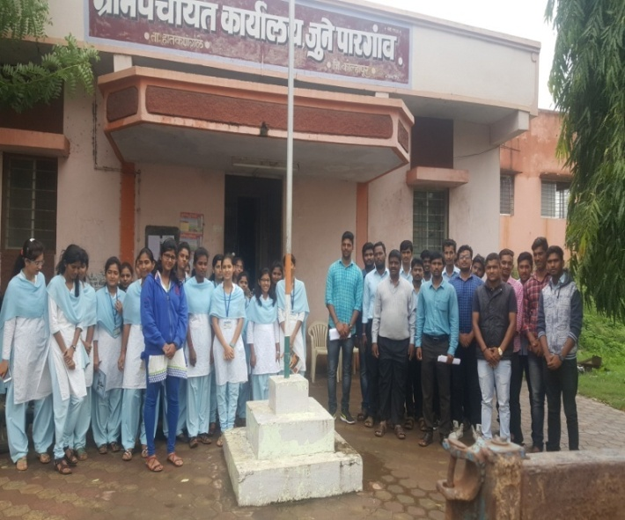
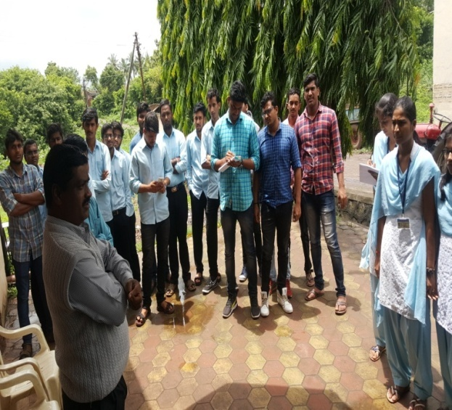
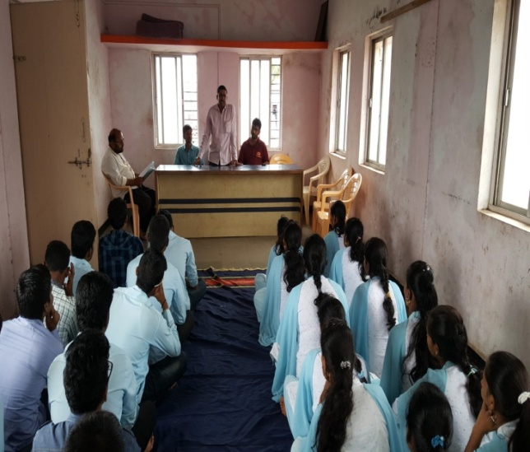
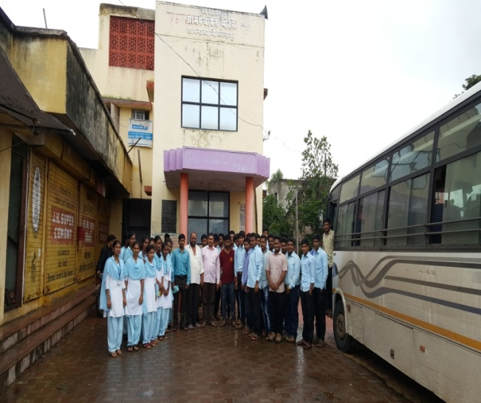
ANNUAL REPORT: STUDENTS EXPOSURE VISIT
2017-18
Photo 1: Visit to Grampanchayat June-Pargaon
Photo 2: Visit to Grampanchayat Mohre

Slide 7
ANNUAL REPORT: STUDENTS EXPOSURE VISIT
2017-18
2) Visit to Pratibha Dairy Processing Unit, Kodoli
SUMMARY
Prof. D. N. Sawant along with 82 TYBSc Agri students
visited to Pratibha Dairy Processing Unit, Kodoli under course
ASDS-353 of SEM V.
The purpose of visit is to get knowledge about, Dairy Processing Unit Starting from reception of milk to produce different milk product. This visit helps to understand all practices which are carried out in Dairy Unit like production, marketing ,trading, quality assurance, different test conducted in lab which is helpful to study this concept deeply & interestingly.

Slide 8
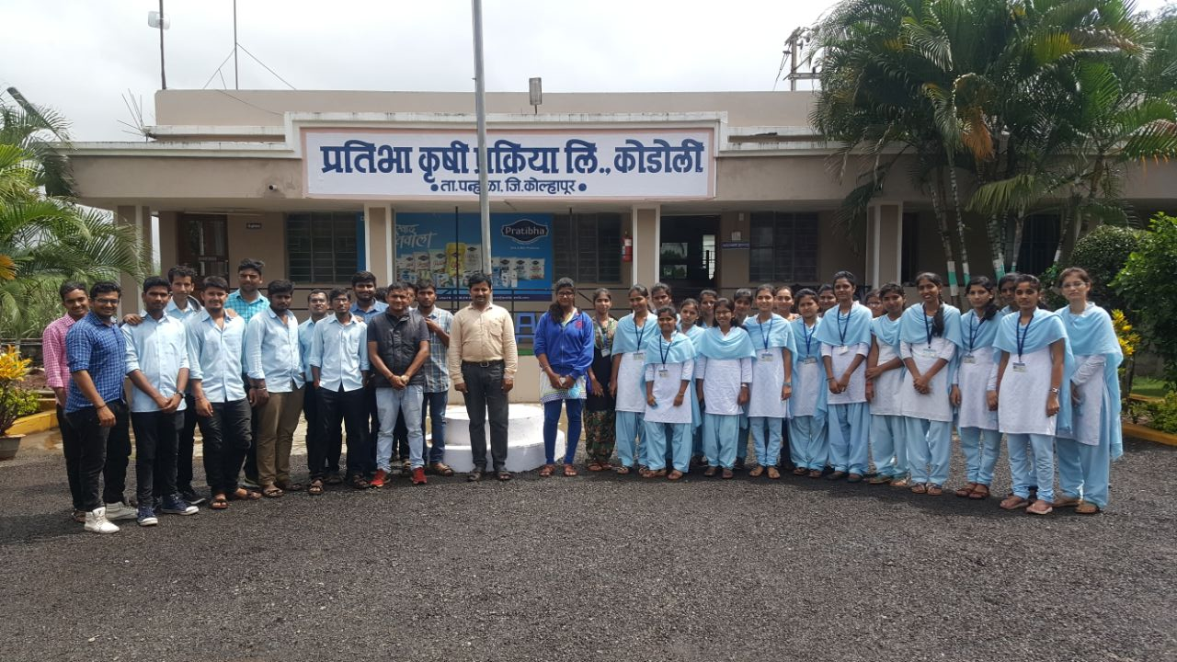
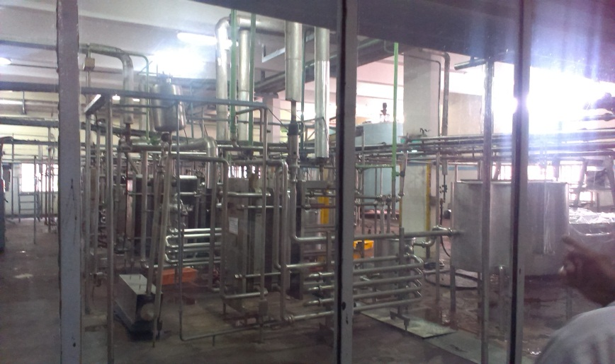
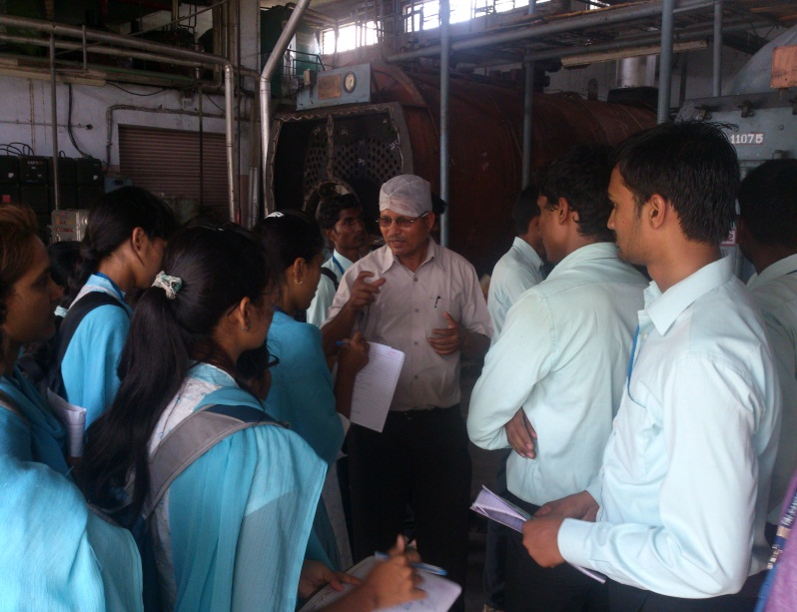
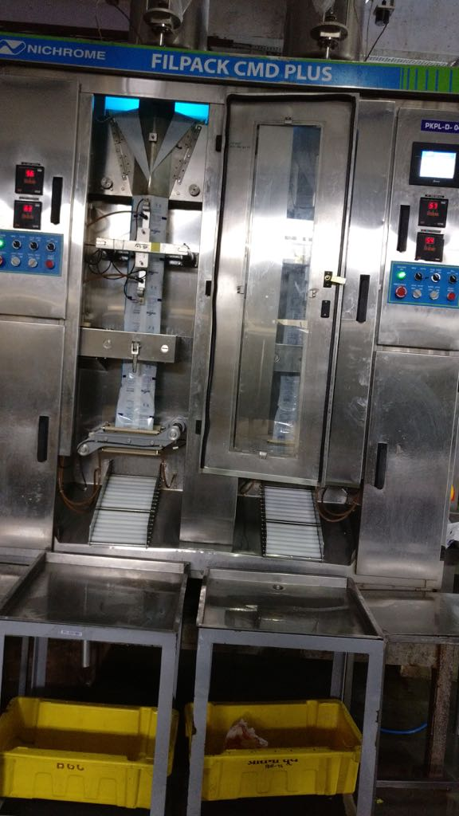
ANNUAL REPORT: STUDENTS EXPOSURE VISIT
2017-18
Photo1: Group photo outside dairy | Photo2: HTST Pasteurizer
Photo3: Employee Provide information and Questions asked by students | Photo4: Packaging Machine

Slide 9
ANNUAL REPORT: STUDENTS EXPOSURE VISIT
2017-18
3) Visit to Lucky Auto Mahindra tractor Dealer Kolhapur
SUMMARY
Prof. Y. V. Patil along with 37 TYBSc Agri students visited to Lucky Auto Mahindra tractor Dealer, Kolhapur under course FMP-236 of SEM V.
Lucky Auto Mahindra Tractor Dealer, Kolhapur, popularly known by its brand name “Lucky Auto” is one of the largest selling of mahindra tractor in kolhapur district. Lucky auto having kolhpur district dealership of mahindra tractor and also avilable all repair and maintennace facility. The information about the new techniques adopted in tractor industries and what are the different repair and maintenance work required for this tractor were given to students by tractor mechanic Mr. Sharad Patil. The students were observed the parts of tractor like water pump, cylinder liner, fuel injection pump, piston etc as well as studied the different systems of the tractor.

Slide 10
ANNUAL REPORT: STUDENTS EXPOSURE VISIT
2017-18
Photo1: Group photo outside dairy | Photo2: HTST Pasteurizer
Photo3: Employee Provide information and Questions asked by students | Photo4: Packaging Machine

Slide 11
ANNUAL REPORT: STUDENTS EXPOSURE VISIT
2017-18
4) Visit to Agriculture Produce Market Committee, Kolhapur
SUMMARY
Prof. Dr. M. G. Lagare along with 50 TYBSc Agri students visited to Shri. Shahu Market Yard , APMC, Kolhapur under course ECON-354 of SEM V.
The purpose of visit was to get knowledge about marketing function, methods of selling. Agricultural produce market committee of Kolhapur is a big market and their working is carried out efficiently. It gives good price to the produce of the farmers. It provides good facilities to the farmers. In APMC farmers get high returns to their product. After visiting APMC, students got actual knowledge of process of APMC market functions like packaging, labelling, transportation, buying, selling and auctioning. Hence we got good information from APMC.

Slide 12
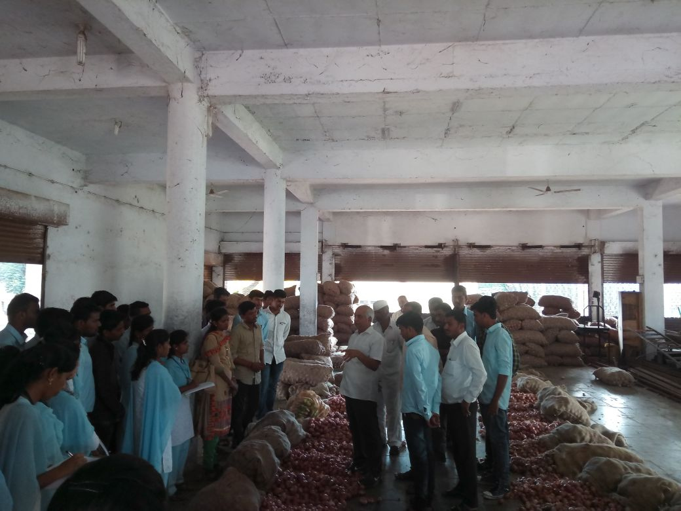
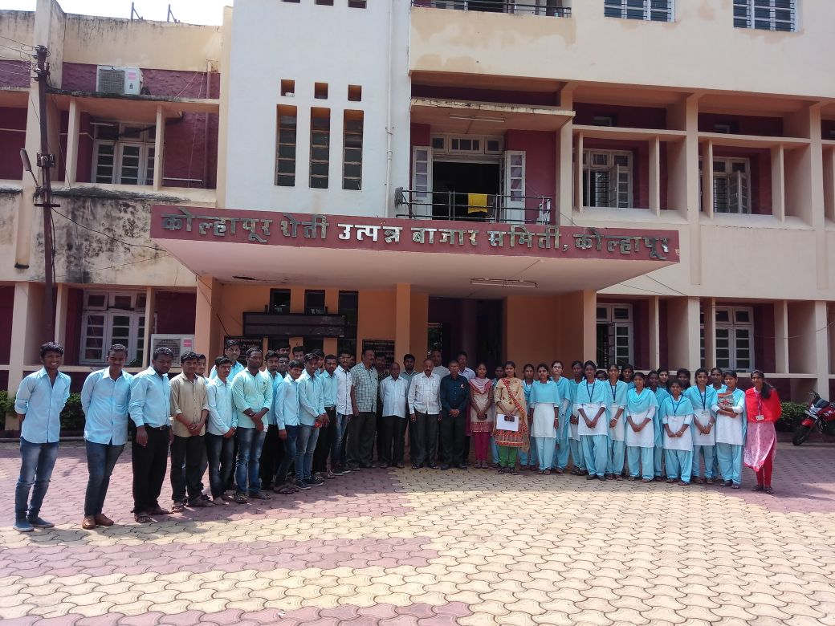
ANNUAL REPORT: STUDENTS EXPOSURE VISIT
2017-18
Photo1: Open auction method of sale | Photo2: Group photo in front of APMC, Kolhapur

Slide 13
ANNUAL REPORT: STUDENTS EXPOSURE VISIT
2017-18
STUDENTS EXPOSURE VISIT
Even Semester
(SEM II, IV, VI, VIII)

Slide 14
ANNUAL REPORT: STUDENTS EXPOSURE VISIT
2017-18
5) Visit to Patwardhan Poultry Farm , Jainapur
SUMMARY
Prof. K. D. Gorad & Prof. D. N. Sawant along with 32 TYBSc Agri students visited to Patwardhan Poultry Farm, Jainapur under course AGRO- 3610 of SEM VI.
This visit helped students to gain knowledge about rearing of poultry birds. This place of visit selected because of students got actual practical knowledge of rearing of poultry birds and their maintainence in Patwardhan Poultry Farm , Jainapur. Manager Mr. Anand Hanbhar given information regarding total capacity of Patwardhan Poultry Farm is 1,00000 birds. This visit changes the vision of students for rearing of poultry birds In future. Most of the students now are willing to start rearing of poultry birds . Student’s got the actual practical knowledge about the rearing of poultry birds. Students are satisfied by visiting the Patwardhan Poultry Farm , Jainapur

Slide 15
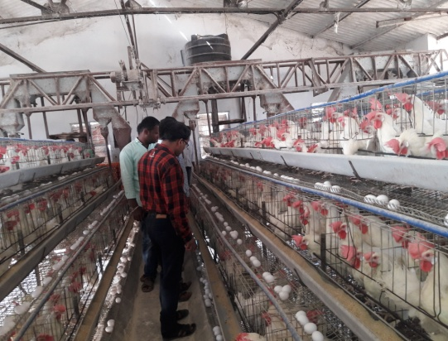
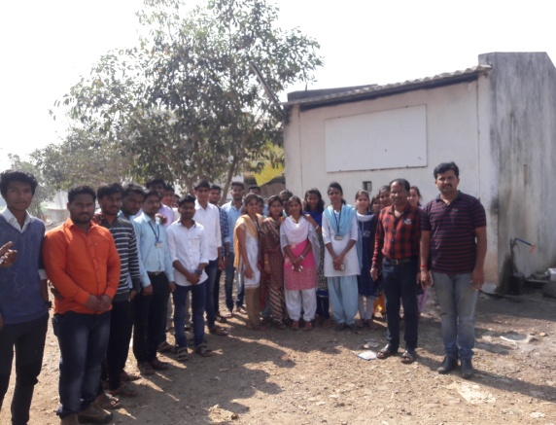
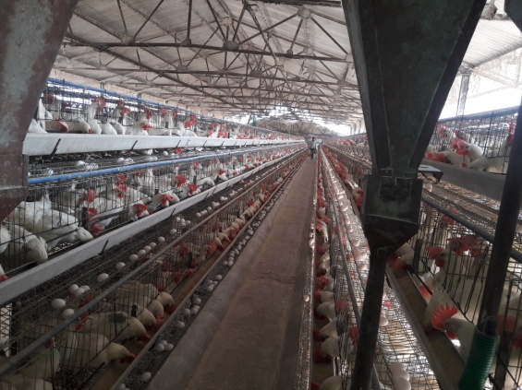
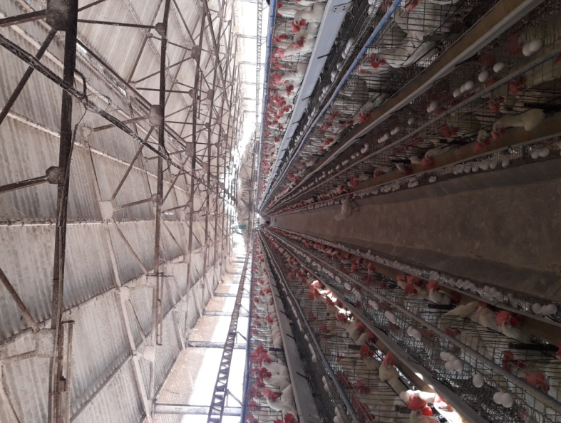
ANNUAL REPORT: STUDENTS EXPOSURE VISIT
2017-18
Photo1: students visiting birds | Photo2: Group photo outside poultry
Photo3: View of raring of birds

Slide 16
ANNUAL REPORT: STUDENTS EXPOSURE VISIT
2017-18
6) Visit to Insect Museum, Biocontrol lab & Plant protection appliances, College of Agriculture Pune
SUMMARY
Prof. R.R.Patil along with 37 SYBSc Agri students visited to College of Agriculture Pune under course ENTO-242 of SEM IV.
The purpose of visit is to to see the Insect Museum, Biocontrol lab & Plant protection appliances. Department of Entomology, AC, Pune Selected for visit because of Laboratory of Entomology are well developed and developed well established bio control production lab. It is also incorporated in syllabus of course as well as students get knowledge about it practically. Visiting Department of Entomology laboratory helps students to know the different insect comes under different family, what kind of instruments they have and which method they fallow for pest management. Students will get valuable knowledge, information and lively see all instruments at free of cost.

Slide 17
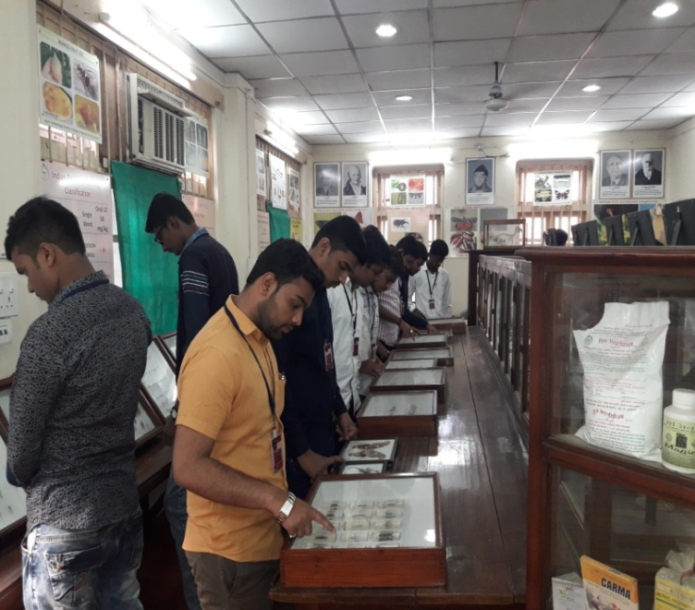
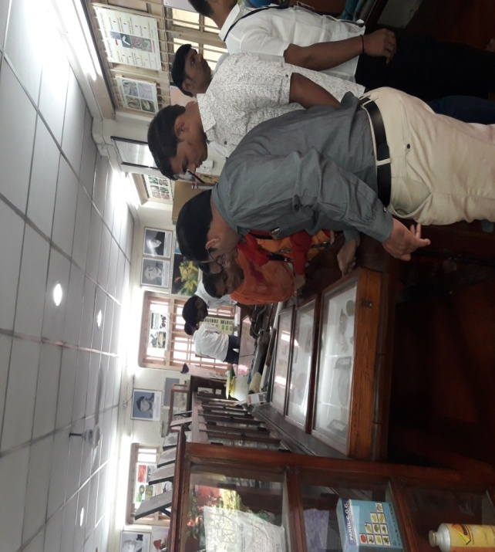
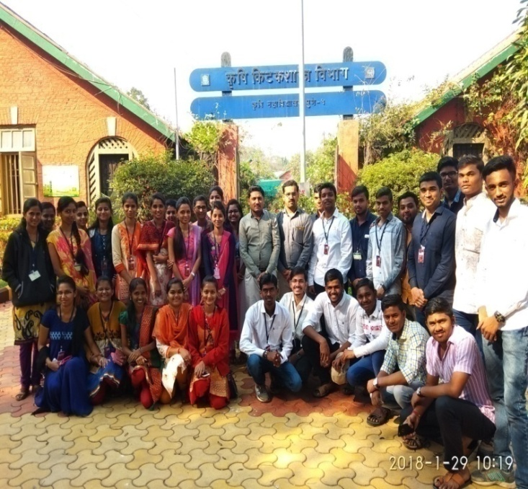
ANNUAL REPORT: STUDENTS EXPOSURE VISIT
2017-18
Photo1: Students visited insect museum | Photo2: Students visited Biocontrol lab
Photo3: Group photo outside entomology dept. of AC Pune

Slide 18
ANNUAL REPORT: STUDENTS EXPOSURE VISIT
2017-18
7) Visit to Rise N Shine Bioplant, Theur ,Pune & KF Bioplant, Pune
SUMMARY
Prof. Prof. S. N. Kolekar along with 34 SYBSc Agri students visited to Rise N Shine Bioplant, Theur ,Pune & KF Bioplant, Pune under course HORT 243 of SEM IV.
The purpose of visit is to encourage the students to set up the own Hi-tech Nursery unit and gain knowledge to allied business. This visit helped students to gain knowledge about how to grow seedlings in under tissue culture. They have explained the stepwise procedure for preparation of tissue culture seedlings along with giving practical demonstrations to students. Visit to KF Bioplant made to study different horticultural crops growing under controlled condition of different cultivars of vegetables, fruit crops and floriculture crops. Students learn different materials used for poly house structure and preparation of economical seedlings and growing of different horticultural crops under controlled condition. This visit changes the vision of students for their future. Most of the students now are willing to start their own small scale Commercial Nursery unit. Student’s got the sound and technical knowledge about the Polyhouse, preparation of tissue Culture seedlings of different crops under tissue culture laboratory .

Slide 19
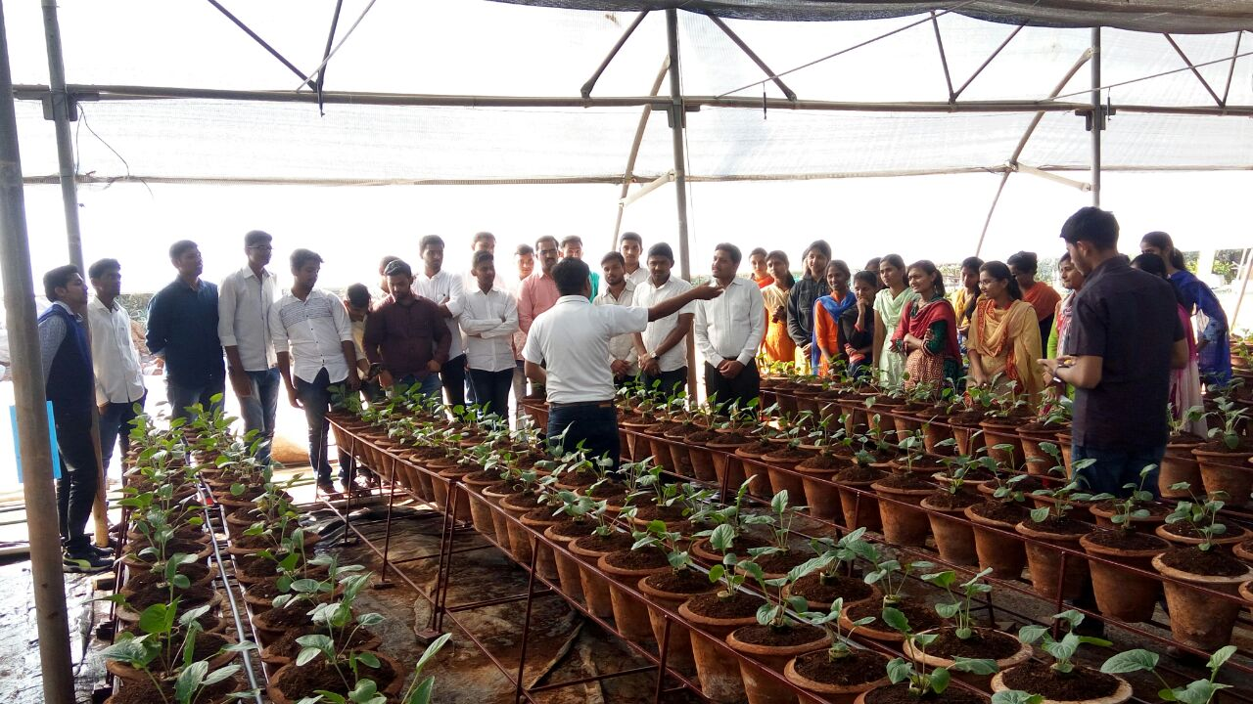
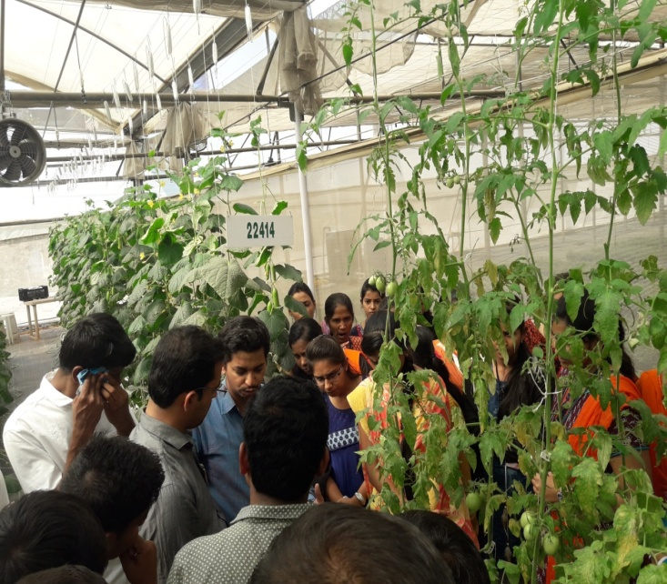
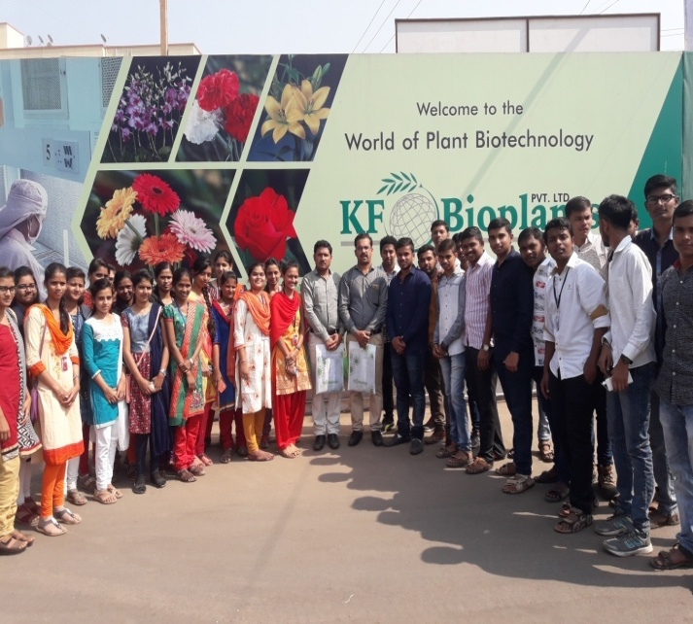
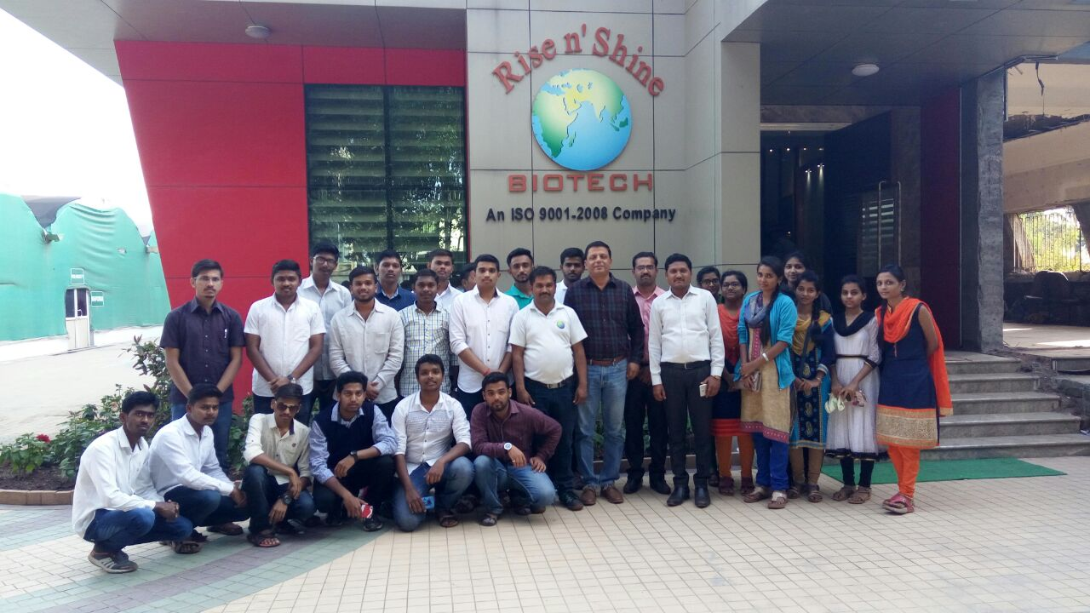
ANNUAL REPORT: STUDENTS EXPOSURE VISIT
2017-18
Photo1: Seedlings prepared in Coco peat | Photo2: Students Interactions with Experts at KF Bioplant
Photo3: Group photo outside KF Bioplant Manjari (BK), Pune | Photo 4: Group photo outside Rise & Shine, Pune

Slide 20
ANNUAL REPORT: STUDENTS EXPOSURE VISIT
2017-18
8) Visit to Praviram Agri-Mall, Kameri
SUMMARY
Prof. Dr. M. G. Lagare along with 37 TYBSc Agri students visited to Praviram Agri-Mall, Kameri under course ECON-365 of SEM VI.
Primary aim of Praviram Agri-Mall is to extend direct interface to farmers with the consumers without any middleman. They are well known trader, manufacturer and supplier of input materials. They have good reputation in farming enterprises. Because of this uniqueness we selected this spot for visit. Praviram purchases inputs from standard manufacturs.Maximum farmers tie up with praviram. They arrange direct supply from manufacture to producer as per their requirement. Develop business association of farmer.Also provide useful information on agriculture to farmers.Serve as an interface between farmers and consumers.Platform for buying and selling of inputs and tools. They provide drip irrigation material, fertilizers,insecticides,pesticides to farmers through agri-malletc.Other services provided by praviram group is production, marketing ,trading and consultancy. This visit make student knowledgeable about different activities of Agri Mall.

Slide 21
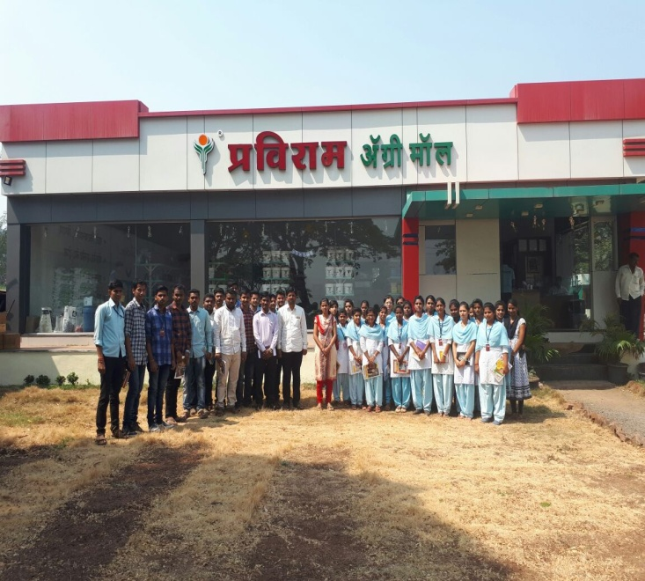
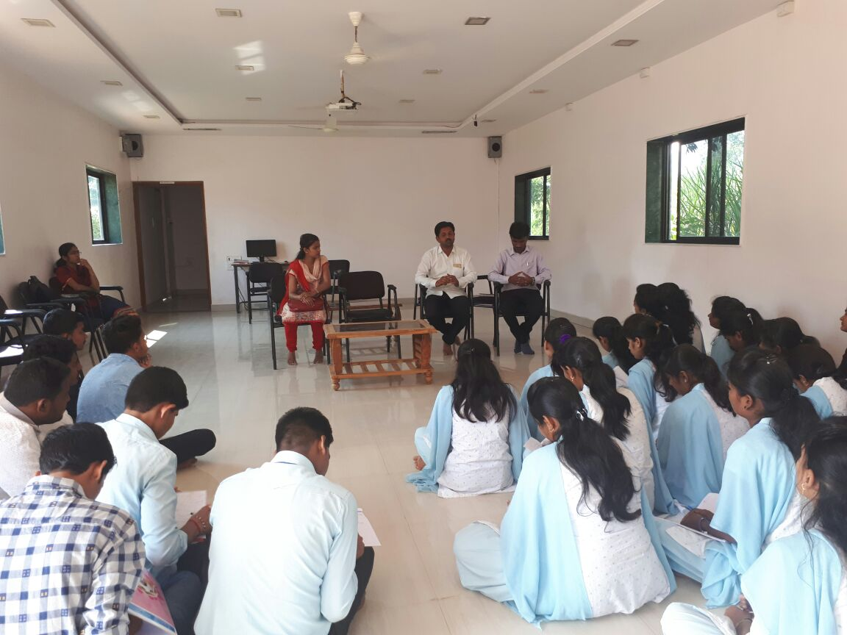
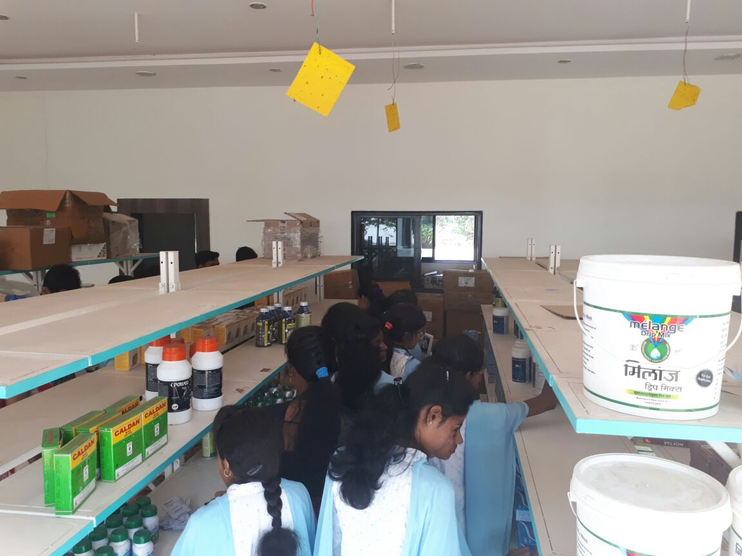
ANNUAL REPORT: STUDENTS EXPOSURE VISIT
2017-18
Photo1: Visit to Praviram Agri-Mall | Photo2: Interaction between students and owner of praviram
Photo3: Observing the products of agri-mall

Slide 22
ANNUAL REPORT: STUDENTS EXPOSURE VISIT
2017-18
9) Visit to seed processing unit, Ashta
SUMMARY
Prof. Dr. A.P. Gaikwad along with 37 TYBSc Agri students visited to MSSCL, seed processing unit, Ashta under course BOT-367 of SEM VI.
Purpose of visit to get knowledge about, practically how seeds were processed & to know about seed processing plant along with their structure, processing sequence. Students visit first time to MSSCL, seed processing unit, Ashta. This visit make student knowledgeable about seed processing. It was helpful to the students to know all processes in stepwise manner actually working in seed processing unit from receiving raw material to the packaging, labeling of processed material.

Slide 23
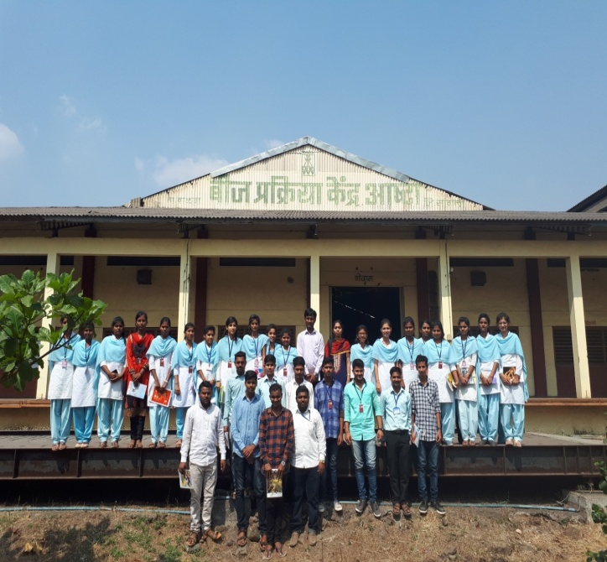
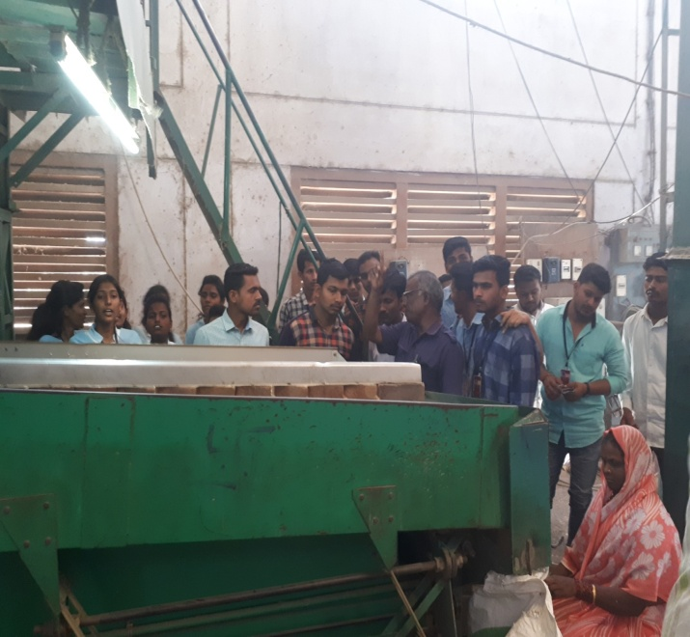
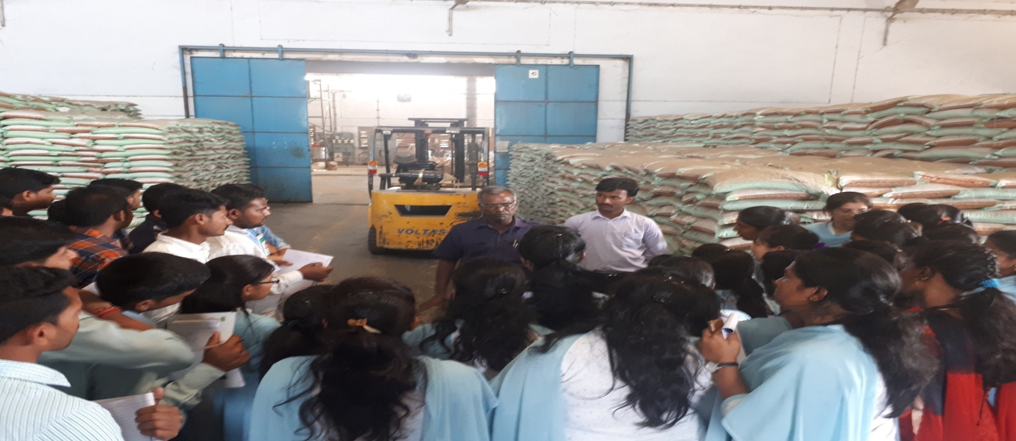
ANNUAL REPORT: STUDENTS EXPOSURE VISIT
2017-18
Photo1: Group photo outiside “Seed processing unit, MSSCL”, Ashta | Photo2:Specific gravity separator (Paddy seed processing).
Photo3: Storage of processed paddy seed bags

Slide 24
ANNUAL REPORT: STUDENTS EXPOSURE VISIT
2017-18
10) Visit to commercial green house, Seema biotech, Talsande & Seed processing unit, Mahabeej Ashta
SUMMARY
Prof. Y. V. Patil along with 37 TYBSc Agri students visited to Seema biotech, Talsande & Mahabeej Ashta under course BOT-367 of SEM VI.
Purpose of visit to get knowledge about various seed processing operation in seed processing unit, poly house and green house crop cultivation practices. In this visit students informed about cultivation practices in poly house, planning and construction of poly house, trading and export of primary produce, inputs and equipments. MSSCL, Asta has a wide range of contemporary processing machinery and equipment suited for seed separation based on different criteria like size, shape, weight, texture etc. Seema Biotech, talsande, Mr. Vishwas Chavan Sir guided and explained about cultivation practices in Green house, planning and construction of Green house, various types of cooling system used for GH and Automized irrigation system for GH.

Slide 25
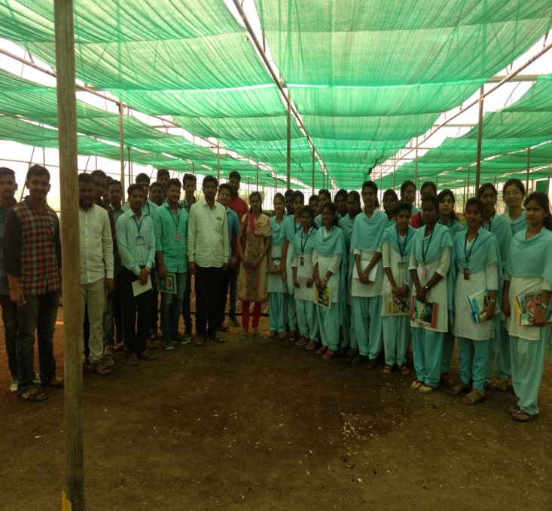
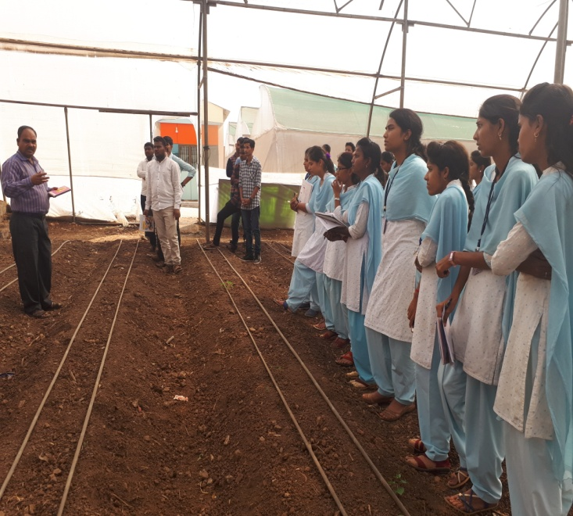

ANNUAL REPORT: STUDENTS EXPOSURE VISIT
2017-18
Photo1: Praviram Poly house Kameri | Photo2: Seema Biotech Green House Talsande
Photo3: Working principle of specific gravity separator at MAHABEEJ Ashta | Photo 4: Student interact with plant manager MAHABEEJ Ashta

Slide 26
ANNUAL REPORT: STUDENTS EXPOSURE VISIT
2017-18
11) Visit to Green Earth Agrobiotech Biofertilizer unit, Jaysingpur
SUMMARY
Prof. R.N. Magdum along with 15 final Year BSc Agri students visited to Green Earth Agrobiotech Biofertilizer unit, Jaysingpur under course AEL PATH – 487 (Module) of SEM VIII.
Purpose of visit is Students to get acquainted with commercial biofertilizers technology. Students learned about working of biofertilizer production unit, different strains of cultures, network of marketing and the fertilizers prepared. From the conducted visit we acquired detail practical knowledge about biofertilizer production from isolation to mass production and packaging to viability of product up to expiry.

Slide 27
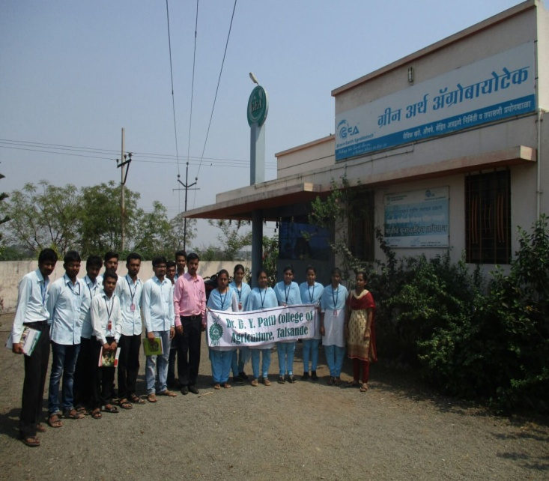
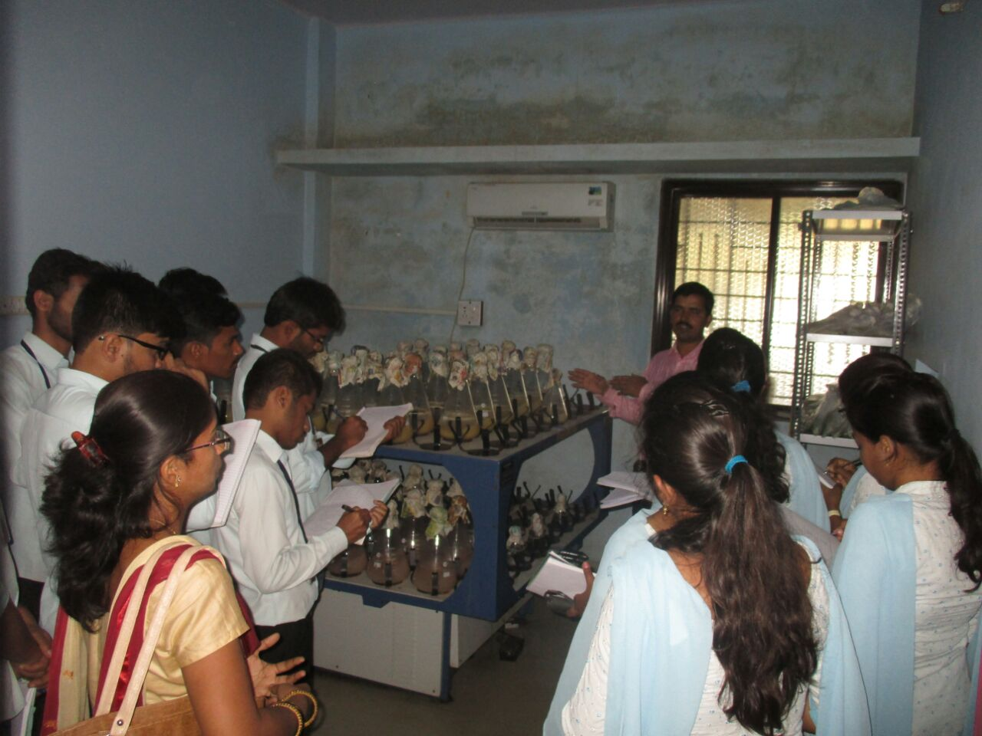
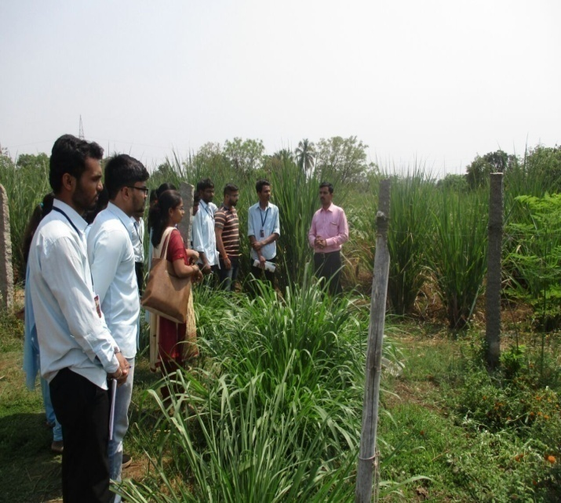
ANNUAL REPORT: STUDENTS EXPOSURE VISIT
2017-18
Photo1: Visit to “Green Earth Agrobiotech” Biofertilizer unit, Jaysingpur | Photo2: Mass production Laboratory
Photo3: Visit to Organic Farming plot

Slide 28
ANNUAL REPORT: STUDENTS EXPOSURE VISIT
2017-18
12) Visit to Siddhivinayak Agrotech Cold storage and Ketan Packing House
SUMMARY
Prof. Dr. N. D. Narkaralong with 36 TYBSc Agri students visited to Siddhivinayak Agrotech Cold storage and Ketan Packing House, KavatheEkand under course HORT 364 of SEM VI.
The visit purposively made to study different size and types of corrugated fiber boxes (local and export), low density polyethylene bags (65 and 85 GSM), raising preparatory solutions (dipping solution- olive oil, potassium carbonate- 24%). As concluding part of the visit we also organized the study of different types of shade nets (25%, 75 % and 90 %), mulching paper, aluminum foils, plastic crates and retail marketing polythene bags in the same packing house. Most of the students now are willing to start their own small scale processing unit. Student’s got the sound and technical knowledge about the cold storage, raisin processing and different packaging material.

Slide 29
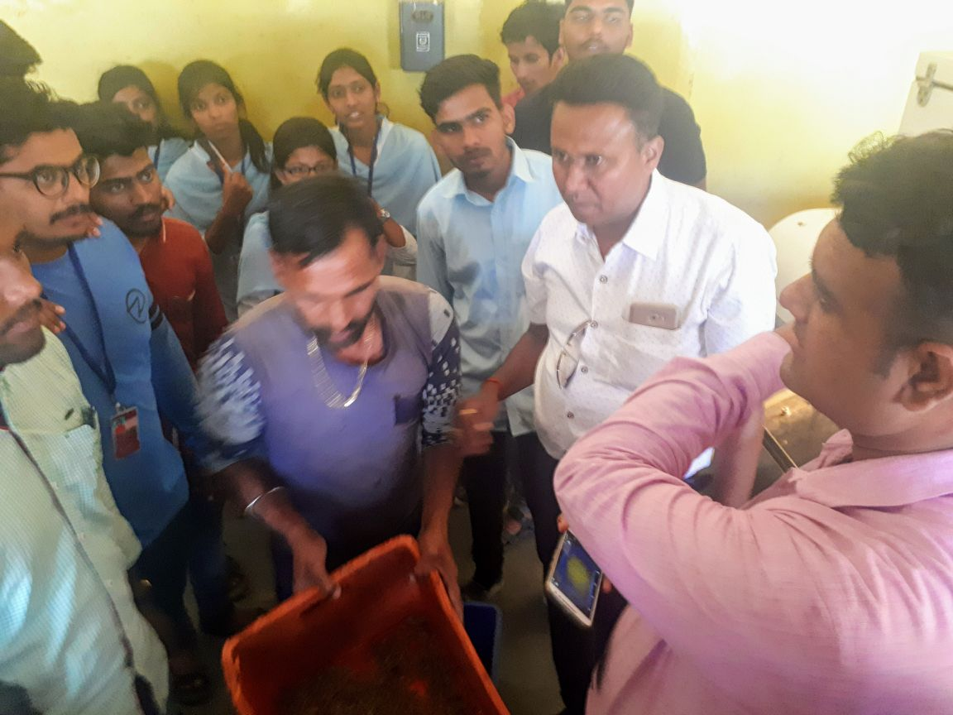
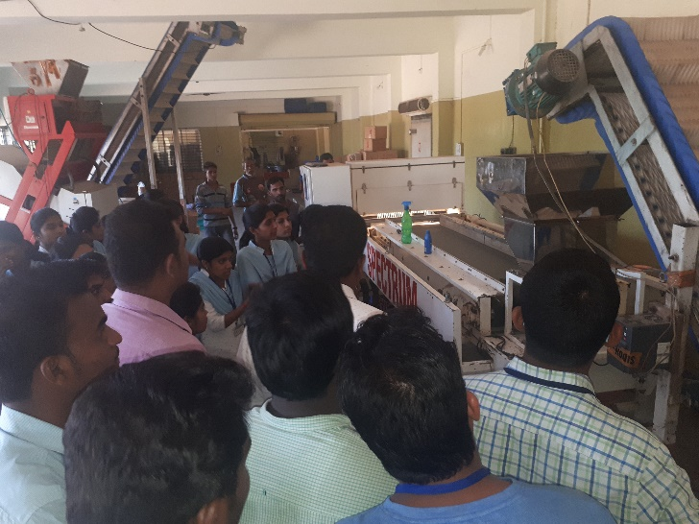
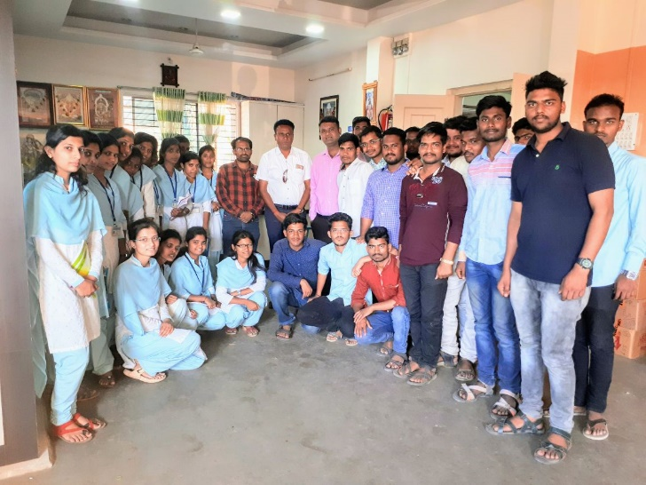
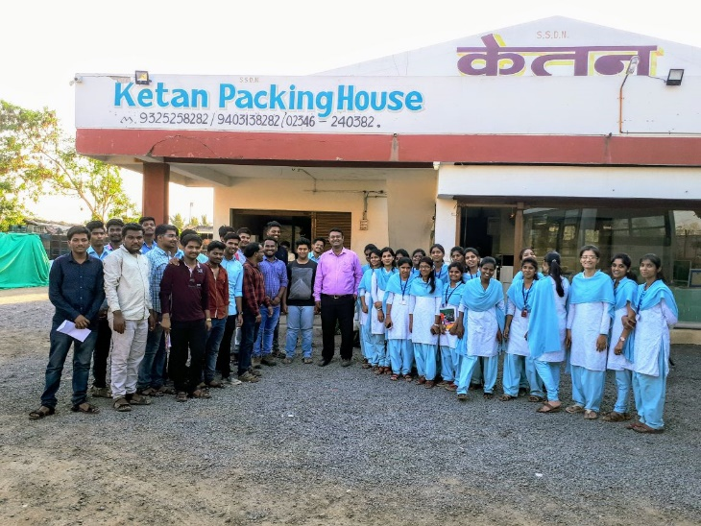
ANNUAL REPORT: STUDENTS EXPOSURE VISIT
2017-18
Photo1: Raisin processing explanation | Photo2: Raisin grading machine
Photo3: See of to Mr. Sudam Mali (at center in white shirt) | Photo4: See of to Mr. Ketan Ahuja (at center in black TShirt)

Slide 30
ANNUAL REPORT: STUDENTS EXPOSURE VISIT
2017-18
13) Visit to Shri Shri Sadgurukripa Agritech Organic Farm, Bagni
SUMMARY
Prof. K. D. Gorad with 36 TYBSc Agri students visited to Shri Shri Sadgurukripa Agritech Organic Farm, Bagni under course AGRO- 3610 of SEM VI.
The purpose of visit is to enable the students to start the Organic Farming unit on his own Farm. Kakasaheb Patil started cropping systems like 1) Organic Sugarcane+ Organic Coriender plot on his own farm. 2) Organic Pomegranet+ Organic ginger.3) Organic Groundnut+ Organic Coriender.4) Organic Cucumber+ Organic Cowpea.5) Sole Cropping of Organic Pre Seasonal Sugarcane 6) Organic Pomegranet + Organic Onion. They Gave Information Regarding application of organic manures and fertilizers , like well decomposed farm yard manure, green manure, vermicompost, crop residues and incorporation of weeds In the field before flowering stage. and also they gave information regarding preparation of vermicompost, preparation of jivamrit , preparation of dashparni ark, preparation of organic pesticides from leaves of papaya and leaves of custard apple.

Slide 31
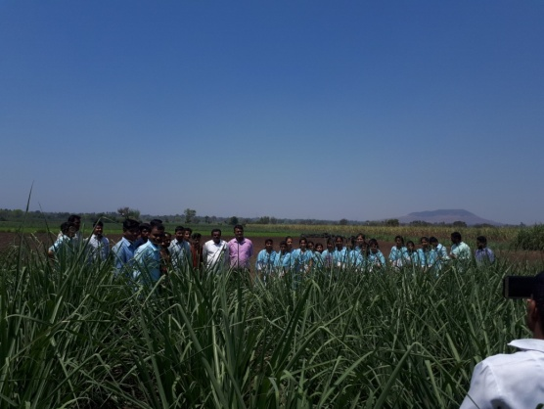
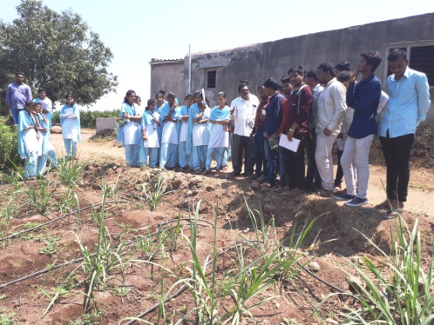
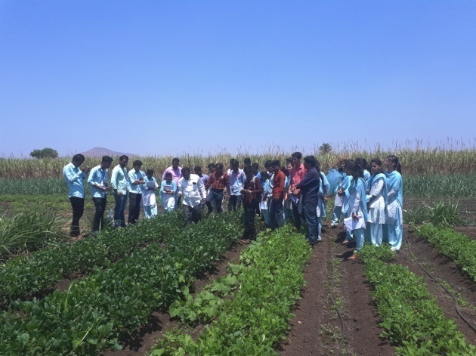
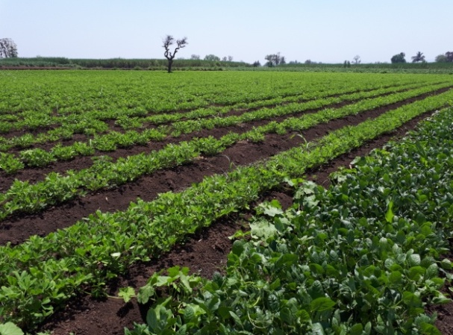
ANNUAL REPORT: STUDENTS EXPOSURE VISIT
2017-18
Photo1: RSole Cropping of Organic Sugarcane | Photo2: Organic Sugarcane + Organic Coriender
Photo3: Organic Ridgeguard | Photo4:Organic Groundnut +Organic Cowpea

Slide 32
ANNUAL REPORT: STUDENTS EXPOSURE VISIT
2017-18
Summary of Students Exposure Visit 2017-18
In-charge Exposure Academics Incharge Principal Visit
Sr. No. | Semester | No. of Visits
1 | I | 00
2 | II | 00
3 | III | 00
4 | IV | 02
5 | V | 04
6 | VI | 06
7 | VII | 00
8 | VIII | 01
Total Visits |  | 13

Slide 33
ANNUAL REPORT: STUDENTS EXPOSURE VISIT
2017-18
To,
The Principal
DYPCA, Talsande
Respected Sir,
I am pleased to submit 31 page annual report on students exposure visit for the year 2017-18. During this year 13 visits was conducted out of which 4 in Odd semester and 9 in even semester.
Kind request you to accept it.
Dr. V. R. Patil
Exposure Visit Incharge
Asst. Prof & HOD
Department of Agril. Botany

