Slide 1

ANNUAL
REPORT
2019-20
Exposure Visits
In-charge
Dr. V. R. Patil
Assistant Professor
Dept. of Agril. Botany

Slide 2
ANNUAL REPORT: STUDENTS EXPOSURE VISIT
2019-20
INTRODUCTION
Students Study and Educational Tours, to well-known institutes and organizations and interaction with faculty help students broaden their knowledge and skills. "Human memory is picture oriented and not word oriented." This is the main concept behind an education tour.
Education tour is nothing but the planned combination of tours, site visits with the target of global learning which can enhance the knowledge of students and can help them to see the clear picture of the theoretical things they have learnt so far. They can gain a deeper understanding of real life situations and trends than a book can ever convey.

Slide 3
ANNUAL REPORT: STUDENTS EXPOSURE VISIT
2019-20
INDEX
Sr. No. | Title of Visit | Place | Date | Page
A | Odd Semester (SEM I, III, V, VII)
 | SEM V
1 | Visit to Milk Dairy | Yalgud | 14-09-2019 | 7
2 | Visit to Regulated Market “Agricultural Produce Market Committee” | Kolhapur | 21-09-2019 | 9
3 | Visit to “Central Warehousing Corporation (CWC)” | Kolhapur | 21-09-2019 | 11
4 | Visit to “Sahakar Bakery Unit | Yalgud, Kolhapur | 14-09-2019 | 13
5 | Visit to certified seed production plot of rice variety | Kasba Bawda, Kolhapur | 14-09-2019 | 15
B | Even Semester (SEM II, IV, VI, VIII)
 | SEM II
6 | Visit to Farm of Farmer Mr. Milind Sankpal | Kerli | 29-02-2020 | 18
 | SEM IV
7 | Visit Commercial biofertilizer production unit in Dept. of Plant Pathology, Agriculture college Kolhapur | Kolhapur | 07-03-2020 | 20
8 | Visit to Chickpea Seed Production Plot, ARS, Kasabe Digraj | Kasabe Digraj | 18-01-2020 | 22
9 | Visit to MSSCL, Seed processing unit | Ashta | 18-01-2020 | 24

Slide 4
ANNUAL REPORT: STUDENTS EXPOSURE VISIT
2019-20
INDEX
Sr. No. | Title of Visit | Place | Date | Page
 | SEM VI
10 | Visit to Apiculture unit | Giroli Kolhapur | 27-01-2020 | 26
11 | Visit to KF Bio-plants Pvt. Ltd. | Manjari Bk. Pune | 14-12-2019 | 28
 | SEM VIII
12 | Visit to Commercial vegetable production plot | Vadgoan | 21-02-2020 | 29
13 | Visit to “Sphurti Dairy Processing Unit | Gokul Shirgaon | 22-02-2020 | 31
14 | Visit to Organic Farming at Kaneri math | Kaneri | 05-03-2020 | 33
15 | Soil Testing Laboratory at college of agriculture Kolhapur | Kolhapur | 05-03-2020 | 35

Slide 5
ANNUAL REPORT: STUDENTS EXPOSURE VISIT
2019-20
STUDENTS EXPOSURE VISIT
Odd Semester
(SEM I, III, V, VII)

Slide 6
ANNUAL REPORT: STUDENTS EXPOSURE VISIT
2019-20
1. Visit to Milk Dairy, Yalgud
Course No. | : | ASDS-353
Course Teacher | : | Dr. A. S. Mukhekar
Course Title | : | Technology of Milk and Milk Products
Purpose of visit | : | Education (Course Visit)
Place of visit | : | Yalgud (Kolhapur)
Class of students | : | Third Year B.Sc. Agri SEM -V
No. of Students | : | 94
Spots Visited | : | Shri.Hanuman Sahakari Dudh Vyavasaik Va Krushipurak seva sanstha Limited,Yalgud, Kolhapur
Staff Accompanied |  | Dr. D.C.Kadam, Prof. V.M. Yadav
Date of visit | : | 14th September 2019

Slide 7
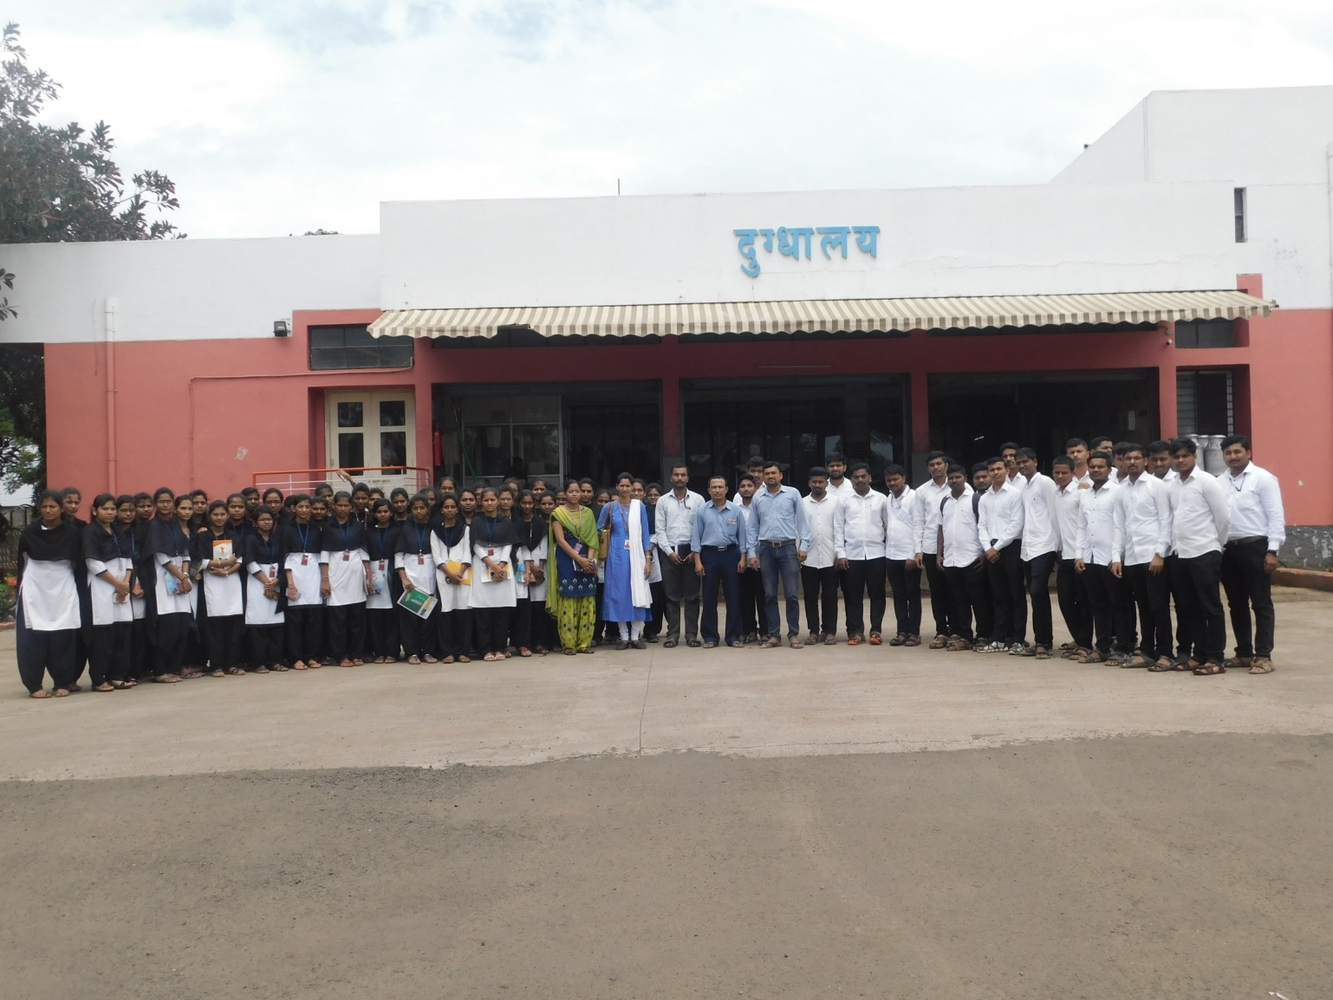
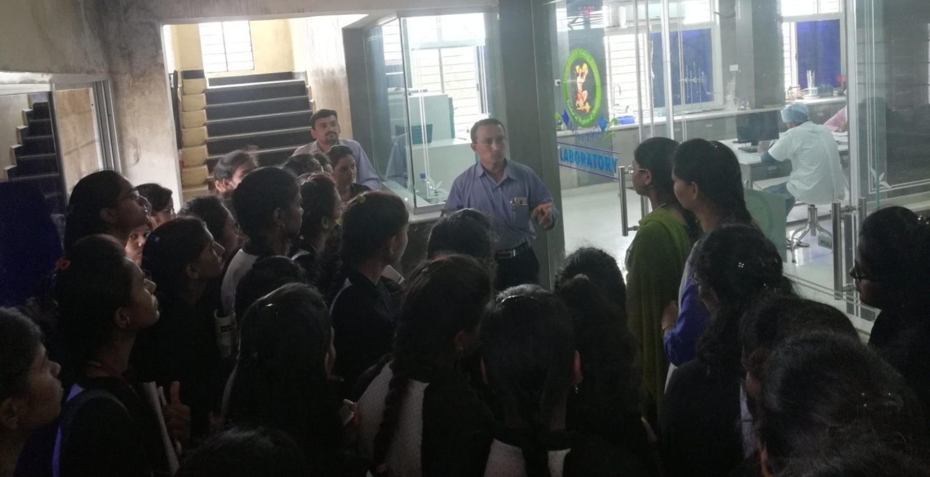
ANNUAL REPORT: STUDENTS EXPOSURE VISIT
2019-20
Photo 1: Visit to “Yalgud Dairy Processing Unit, Kolhapur”
Photo 2: Lab Incharge gave information about their analysis Lab

Slide 8
ANNUAL REPORT: STUDENTS EXPOSURE VISIT
2019-20
2. Visit to Regulated Market “Agricultural Produce Market Committee” Kolhapur
Course No. | : | ECON 353
Course Teacher | : | Mrs. S. J. Misal
Course Title | : | Agricultural Marketing Trade & Prices
Purpose of visit | : | Get acquainted with how regulated market were running & to know Method of Sale, Grading of produce, Market charges, Licensing of market functionaries, Provision of amenities in the market.
Place of visit | : | APMC, Kolhapur
Class of students | : | B.Sc.Agri.3rd year ( Sem.-V)
No. of Students | : | 60
Spots Visited | : | APMC, Kolhapur
Staff Accompanied |  | -
Date of visit | : | 21 September, 2019

Slide 9
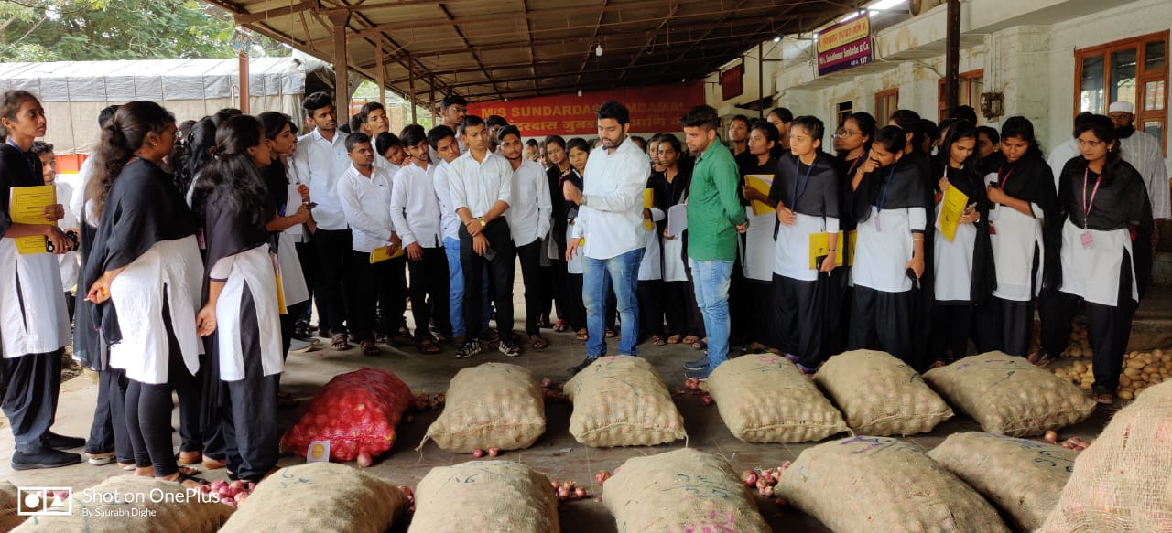
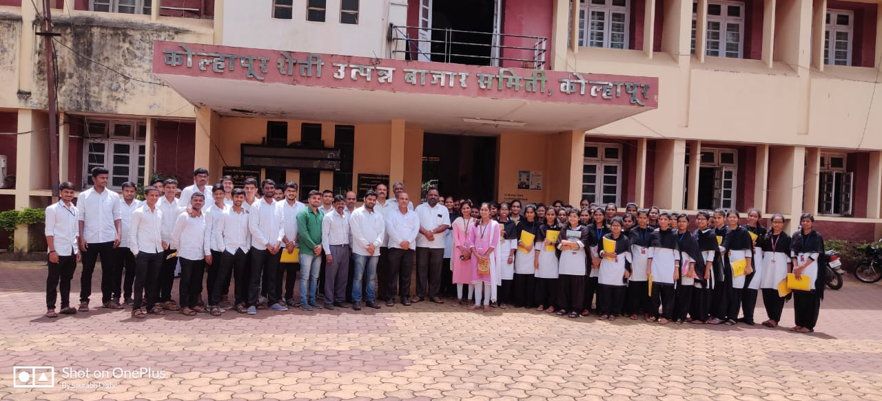
ANNUAL REPORT: STUDENTS EXPOSURE VISIT
2019-20
Photo 1: Visit to “APMC”, Kolhapur
Photo 2: Mr. Milind Sankpal explaining about automization irrigation unit

Slide 10
ANNUAL REPORT: STUDENTS EXPOSURE VISIT
2019-20
3. Visit to “Central Warehousing Corporation (CWC)” Kolhapur
Course No. | : | ECON 353
Course Teacher | : | Mrs. S. J. Misal
Course Title | : | Agricultural Marketing Trade & Prices
Purpose of visit | : | Get acquainted with how cetral wearhousing corporation were working & to know scientific storage methods
Place of visit | : | APMC, Kolhapur
Class of students | : | B.Sc.Agri.3rd year ( Sem.-V)
No. of Students | : | 60
Spots Visited | : | APMC, Kolhapur
Staff Accompanied |  | -
Date of visit | : | 21 September, 2019

Slide 11
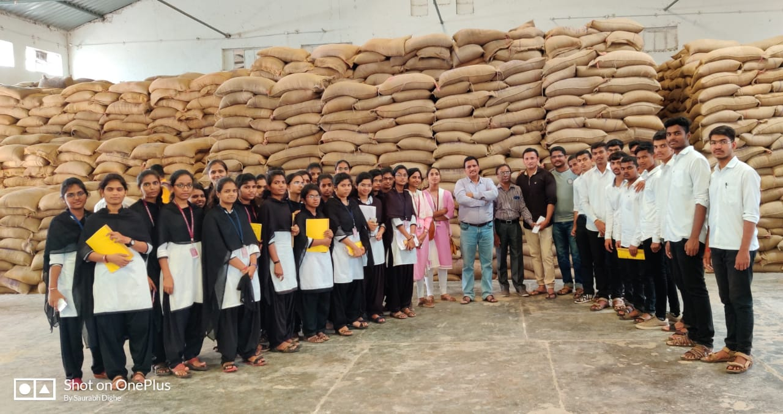
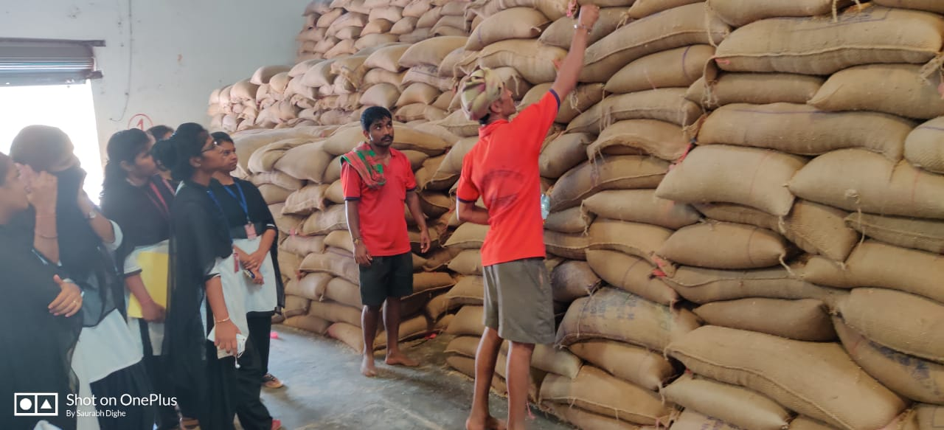
ANNUAL REPORT: STUDENTS EXPOSURE VISIT
2019-20
Photo 1: Visit to “Central Warehousing Corporation”, Kolhapur
Photo 2: Demonstration of Fumigation to food-grain bag.

Slide 12
ANNUAL REPORT: STUDENTS EXPOSURE VISIT
2019-20
4. Visit to “Sahakar Bakery Unit, Yelgude, Kolhapur
Course No. | : | EXTN-355
Course Teacher | : | Ms. V. M. Yadav
Course Title | : | Entrepreneurship Development and Business Communication
Purpose of visit | : | Education (Course Visit)
Place of visit | : | Yelgude Dairy Enterprise, Yelgude (Kolhapur)
Class of students | : | Third Year B.Sc. Agri
No. of Students | : | 100
Spots Visited | : | Yelgude Dairy Enterprise, Yelgude (Kolhapur)
Staff Accompanied |  | Dr.A.S.Mukhekar
Date of visit | : | 14th September, 2019

Slide 13
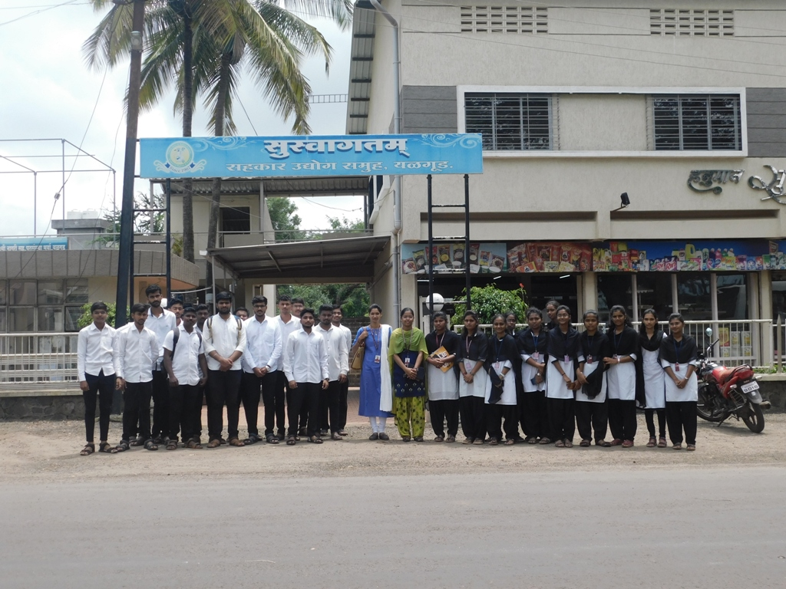
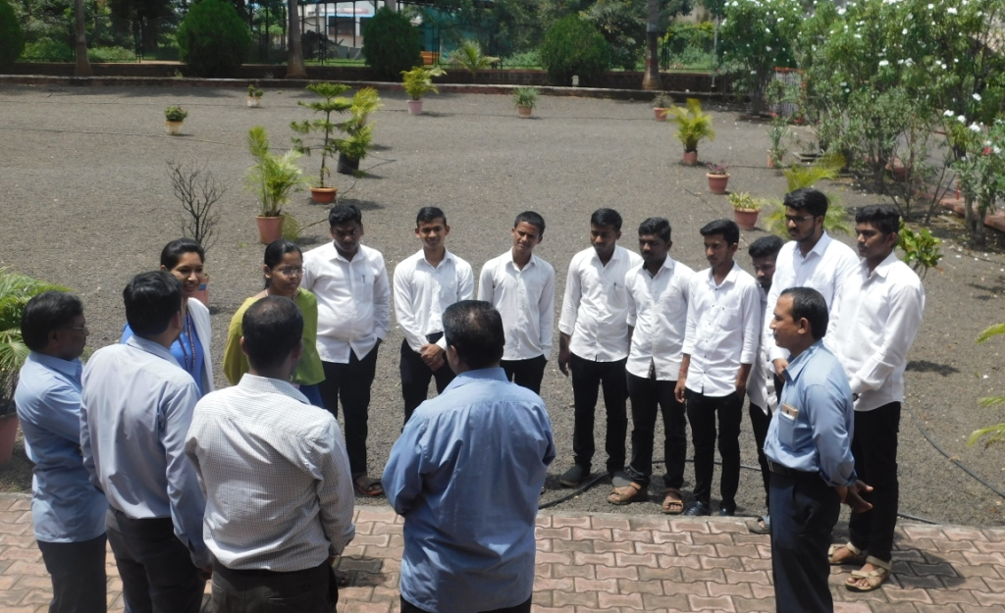
ANNUAL REPORT: STUDENTS EXPOSURE VISIT
2019-20
Photo 1: Visit to Shakar Udyog Samuha Yalgud
Photo 2: Manager gave information about establishment of Yelgude Sahakar Unit

Slide 14
ANNUAL REPORT: STUDENTS EXPOSURE VISIT
2019-20
5. Visit to certified seed production plot of rice variety,
Kasba Bawda, Kolhapur
Course No. | : | GPB-355
Course Teacher | : | Dr. D. C. Kadam
Course Title | : | Crop Improvement – I (Kharif Crops)
Purpose of visit | : | To learn seed production technology
Place of visit | : | Kasba Bawda, Kolhapur
Class of students | : | Vth sem Third Year
No. of Students | : | 94
Spots Visited | : | Certified Seed Production Plot of Rice
Staff Accompanied |  | Dr. A. S. Mukhekar and Prof. V. M. Yadav
Date of visit | : | Saturday, 14th September, 2019

Slide 15
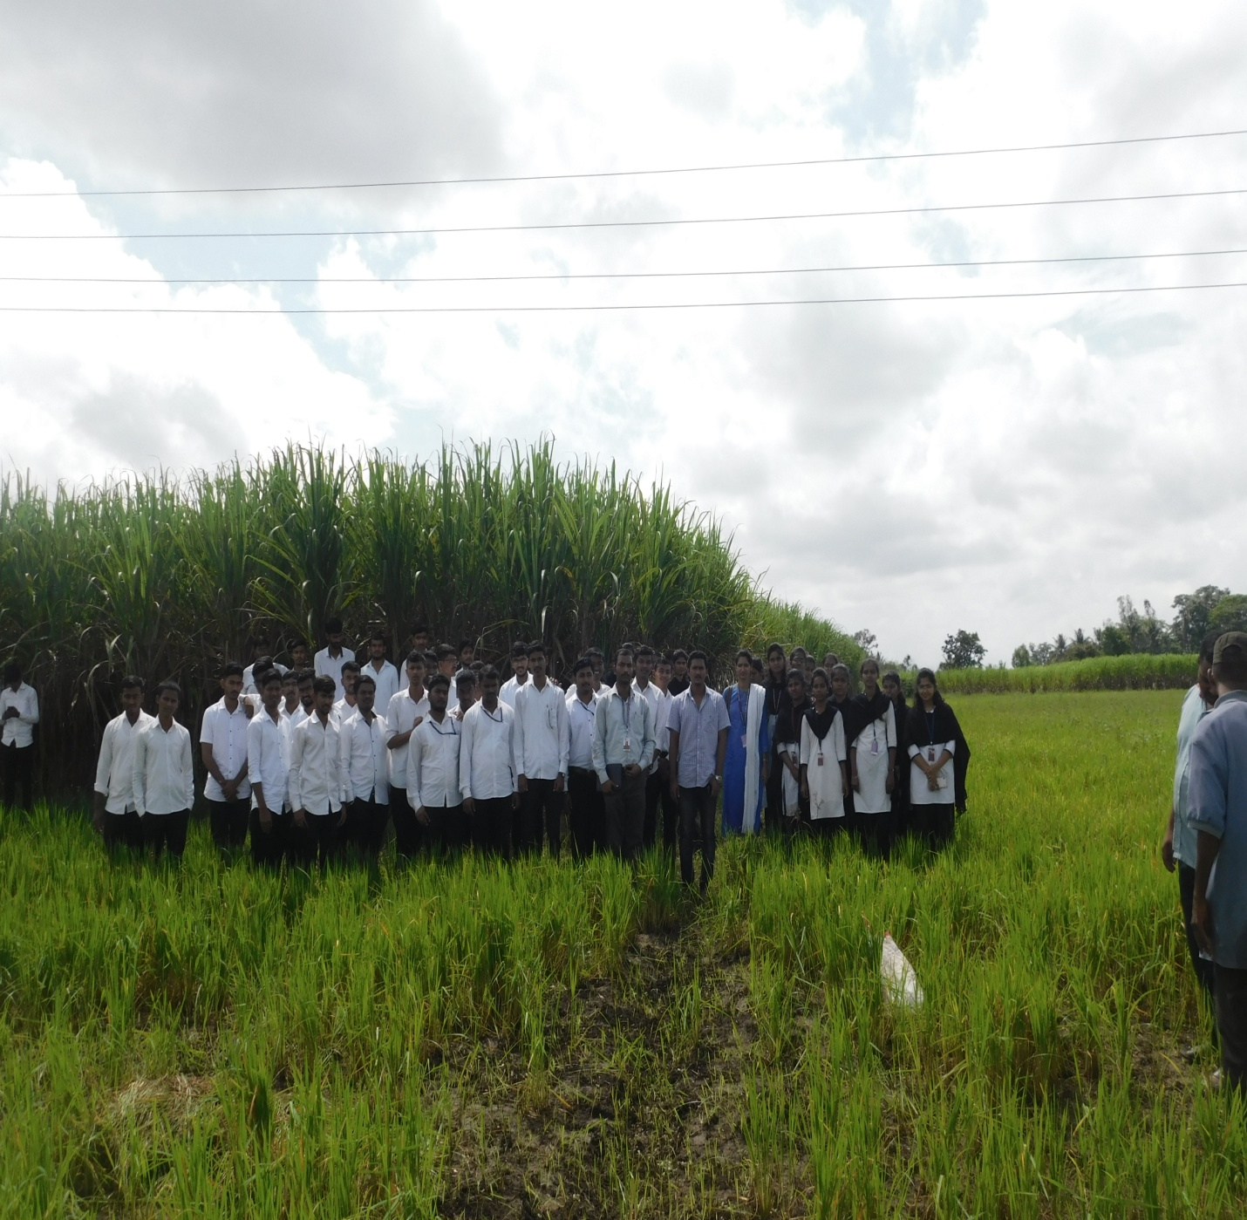
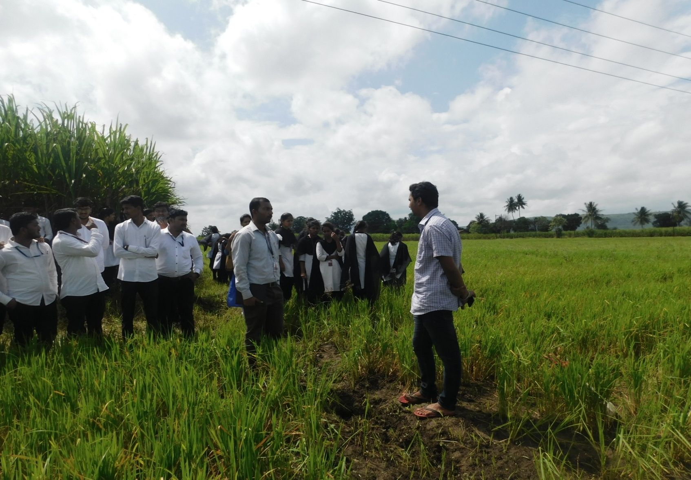
ANNUAL REPORT: STUDENTS EXPOSURE VISIT
2019-20
Photo 1: Visit to certified seed production plot of rice variety Phule Samruddhi located at Kasba Bawda, Kolhapur
Photo 2: Seed producer farmer Shri. Bajirao Patil giving information of rice seed production plot r

Slide 16
ANNUAL REPORT: STUDENTS EXPOSURE VISIT
2019-20
STUDENTS EXPOSURE VISIT
Even Semester
(SEM II, IV, VI, VIII)

Slide 17
ANNUAL REPORT: STUDENTS EXPOSURE VISIT
2019-20
6. Visit to Farm of Farmer Mr. Milind Sankpal at Kerli,
Tal- Panhala
Course No. | : | AGRO-123
Course Teacher | : | Prof. S.R. Suryavanshi
Course Title | : | Fundamentals of Agronomy-II
Purpose of visit | : | To know about Automized irrigation unit
Place of visit | : | C. B. Patil Farm, Kerli, Tal- Panhala, Dist- Kolhapur
Class of students | : | SEM 2, First Year
No. of Students | : | 42
Spots Visited | : | C. B. Patil Farm, Kerli, Tal- Panhala, Dist- Kolhapur
Staff Accompanied |  | -
Date of visit | : | 29th February, 2020

Slide 18
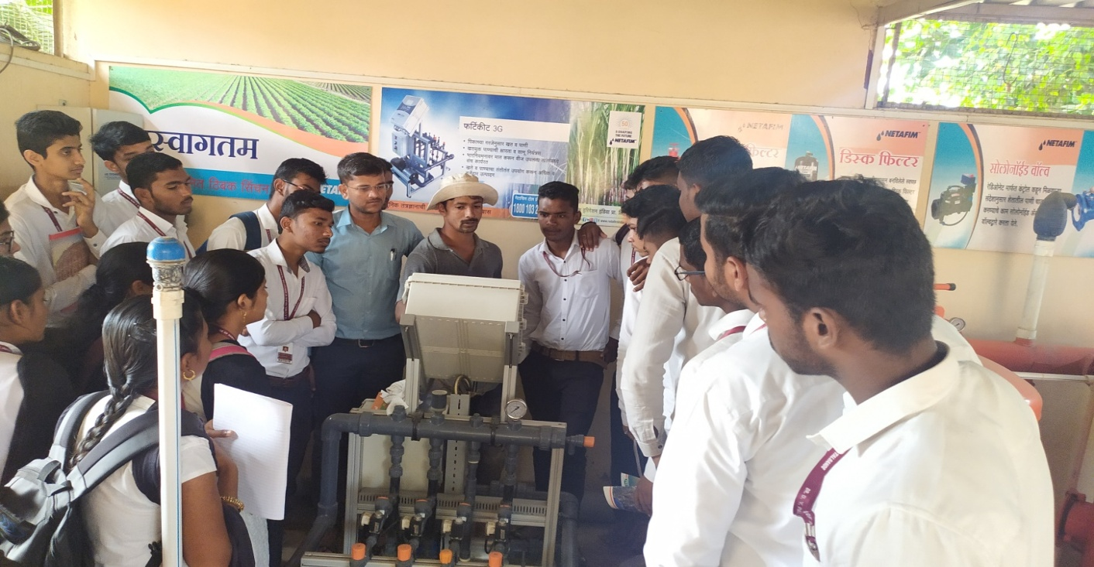
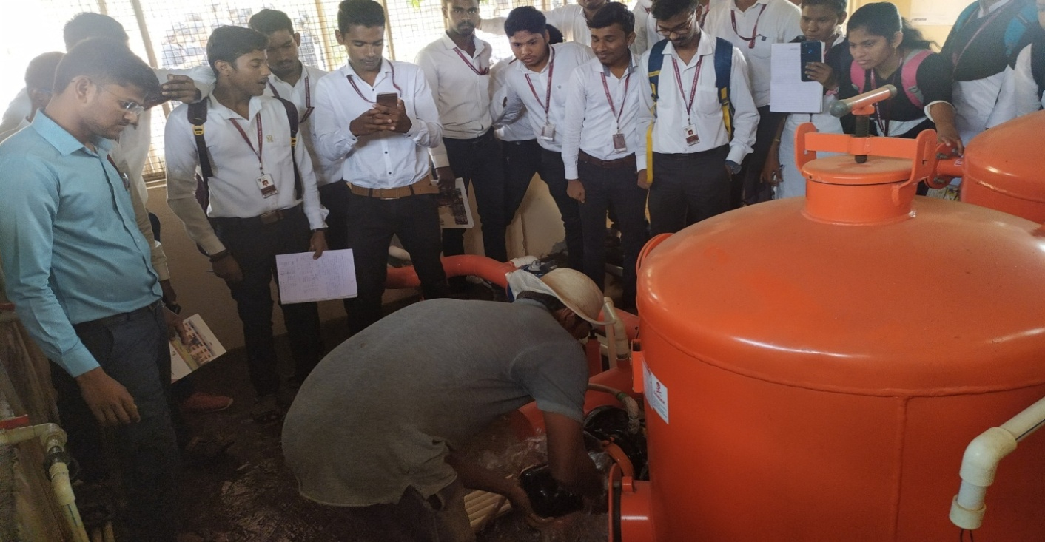
ANNUAL REPORT: STUDENTS EXPOSURE VISIT
2019-20
Photo 1: Visit to Automization irrigation unit at Kerli, Tal- Panhala
Photo 2: Mr. Milind Sankpal explaining about automization irrigation unit

Slide 19
ANNUAL REPORT: STUDENTS EXPOSURE VISIT
2019-20
7. Visit Commercial biofertilizer production unit in Dept. of Plant Pathology, Kolhapur
Course No. | : | ELE PATH 243
Course Teacher | : | Dr. Kalindee S. Shinde
Course Title | : | Biofertilizers, Bio-Control agents and Biopesticides
Purpose of visit | : | 1) To see the commercial production of biofertilizers 2) To acquaint with different equipment’s used for biofertilizer production like fermenter, mixing and curing process 3) To get knowledge about isolation and mass multiplication from expert.
Place of visit | : | Agriculture College, Kolhapur
Class of students | : | SEM 4 S. Y. B. Sc. (Agri.)
No. of Students | : | 34
Spots Visited | : | Commercial biofertilizer production unit in Dept. of Plant Pathology
Staff Accompanied |  | Prof. V. R. Subhedar
Date of visit | : | 7th March, 2020

Slide 20
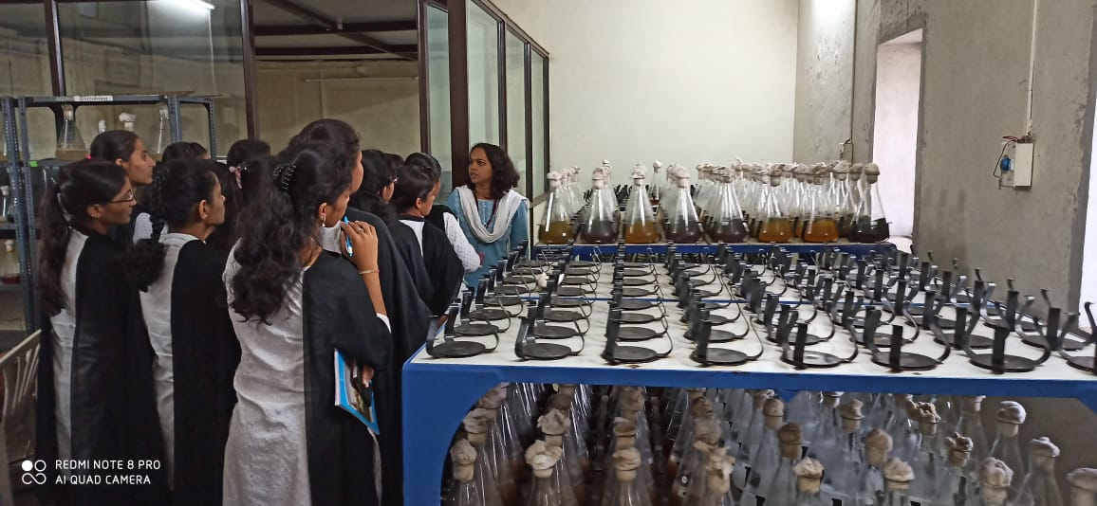
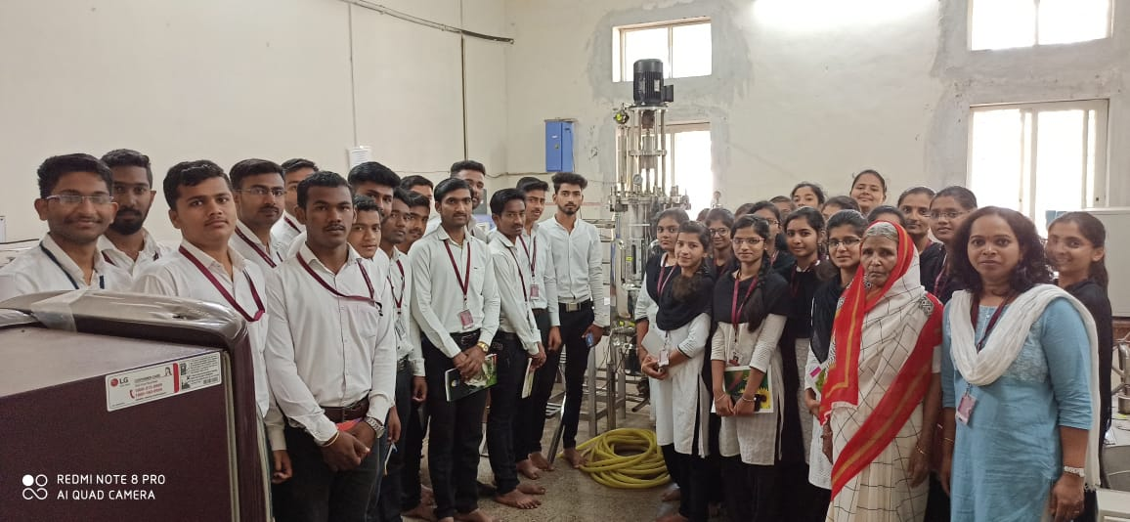
ANNUAL REPORT: STUDENTS EXPOSURE VISIT
2019-20
Photo 1: Mass multiplication of PSB, Azotobacter and Acetobacter on rotary shaker
Photo 2: Fermenter cum sterilizer having capacity of 100 lit broth

Slide 21
ANNUAL REPORT: STUDENTS EXPOSURE VISIT
2019-20
8. Visit to Chickpea Seed Production Plot, ARS, Kasabe Digraj
Course No. | : | GPB 243
Course Teacher | : | Dr. M. Y. Patil
Course Title | : | Principles of Seed Technology
Purpose of visit | : | To know how seed production of Pulse crops (chickpea) is taken also to understand post harvest grading, packaging and processing of rice crop
Place of visit | : | Chickpea Seed Production Plot, ARS, Kasabe Digraj
Class of students | : | SEM 4 S. Y. B. Sc. (Agri.)
No. of Students | : | 38
Spots Visited | : | Chickpea Seed Production Plot, ARS, Kasabe Digraj MSSCL, Seed processing unit, Ashta Tal-Walva, Dist-Sangli
Staff Accompanied |  | Prof. U. A. Mohite
Date of visit | : | 18th January, 2020

Slide 22
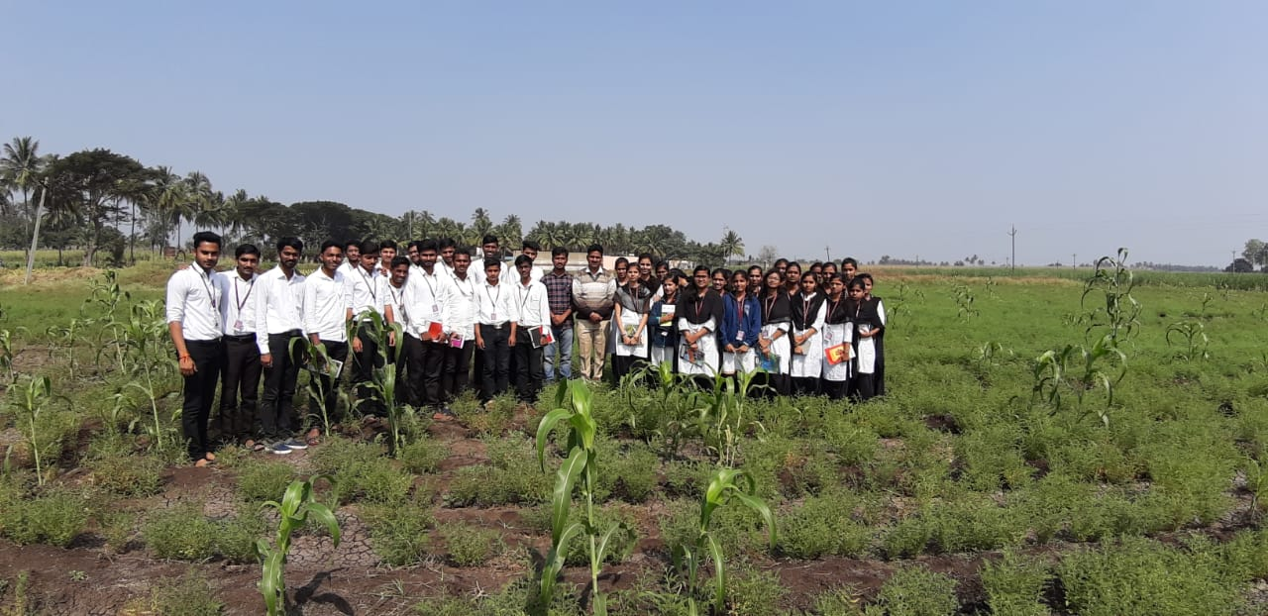
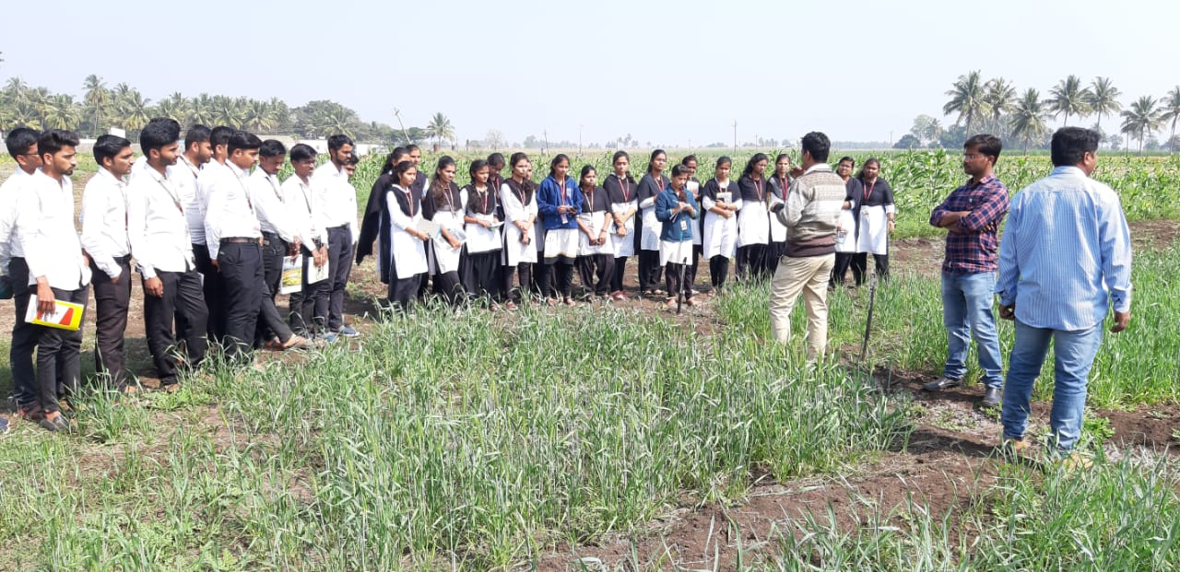
ANNUAL REPORT: STUDENTS EXPOSURE VISIT
2019-20
Photo 1: Visit to Seed Production Plot var. Digvijay at ARS, Kasabe Digraj
Photo 2: Visit to Multiple location trial of wheat strains from Niphad at ARS, Kasabe Digraj

Slide 23
ANNUAL REPORT: STUDENTS EXPOSURE VISIT
2019-20
9. Visit to MSSCL, Seed processing unit, Ashta Tal-Walva, Dist-Sangli
Course No. | : | GPB 243
Course Teacher | : | Dr. M. Y. Patil
Course Title | : | Principles of Seed Technology
Purpose of visit | : | To know how seed production of Pulse crops (chickpea) is taken also to understand post harvest grading, packaging and processing of rice crop
Place of visit | : | MSSCL, Seed processing unit, Ashta Tal-Walva, Dist-Sangli
Class of students | : | SEM 4 S. Y. B. Sc. (Agri.)
No. of Students | : | 38
Spots Visited | : | Chickpea Seed Production Plot, ARS, Kasabe Digraj MSSCL, Seed processing unit, Ashta Tal-Walva, Dist-Sangli
Staff Accompanied |  | Prof. U. A. Mohite
Date of visit | : | 18th January, 2020

Slide 24
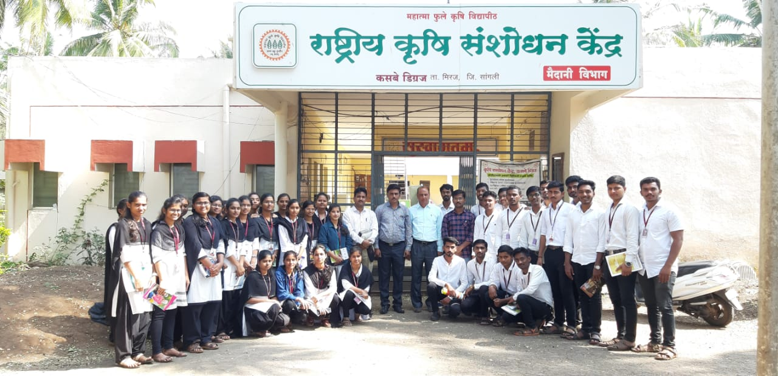
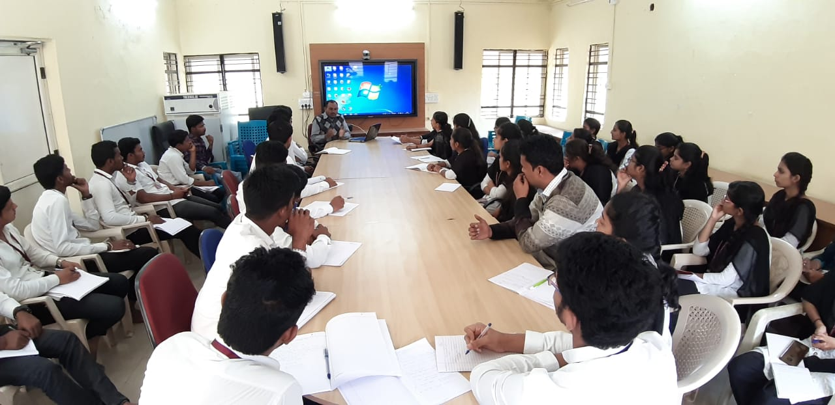
ANNUAL REPORT: STUDENTS EXPOSURE VISIT
2019-20
Photo 1: Students along with Dr. Khatmale Sir and Dr. Rathod Sir ARS, Kasabe Digraj
Photo 2: Dr. Lokare Sir Explaining Varietal and Hybrid seed production to students

Slide 25
ANNUAL REPORT: STUDENTS EXPOSURE VISIT
2019-20
10. Visit to Apiculture unit, Giroli (Kolhapur)
Course No. | : | ENTO-365
Course Teacher | : | Prof. T. S. Kadgaonkar
Course Title | : | Management of Beneficial Insects
Purpose of visit | : | Apiculture unit visit
Place of visit | : | Giroli (Kolhapur)
Class of students | : | SEM 6 Third Year B.Sc. Agri
No. of Students | : | 12
Spots Visited | : | Apiculture unit, Giroli (Kolhapur)
Staff Accompanied |  | Prof. T. S. Kadgaonkar
Date of visit | : | 27th January 2020

Slide 26
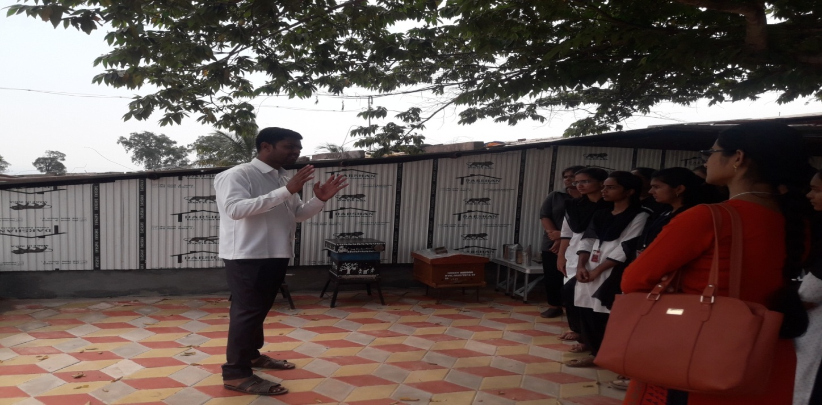
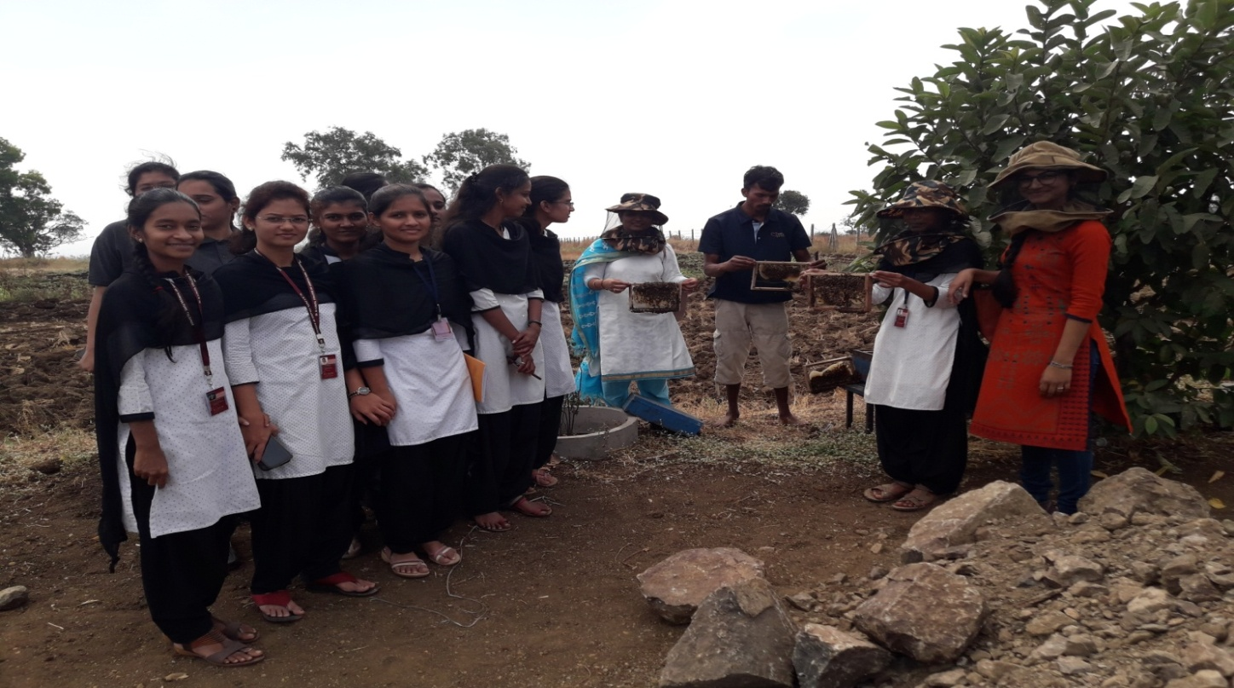
ANNUAL REPORT: STUDENTS EXPOSURE VISIT
2019-20
Photo 1: Shri. kadam V. A. Providing information about Apiculture Unit
Photo 2: Demonstration of Apiary Unit

Slide 27
ANNUAL REPORT: STUDENTS EXPOSURE VISIT
2019-20
11. Visit to KF Bio-plants Pvt. Ltd. Manjari Bk. Pune
Course No. | : | HORT-367
Course Teacher | : | Mr. N. S. Patil
Course Title | : | Landscaping
Purpose of visit | : | Getting extra knowledge about High-tech Horticulture
Place of visit | : | KF Bio-plants Pvt. Ltd. Manjari Bk. Pune
Class of students | : | B.Sc.Agri.3rd year ( Sem.-VI)
No. of Students | : | 35
Spots Visited | : | KF Bio-plants Pvt. Ltd. Manjari Bk. Pune
Staff Accompanied |  | Prof. V. S. Yadav Prof A. S. Pawar
Date of visit | : | 14 December, 2019

Slide 28
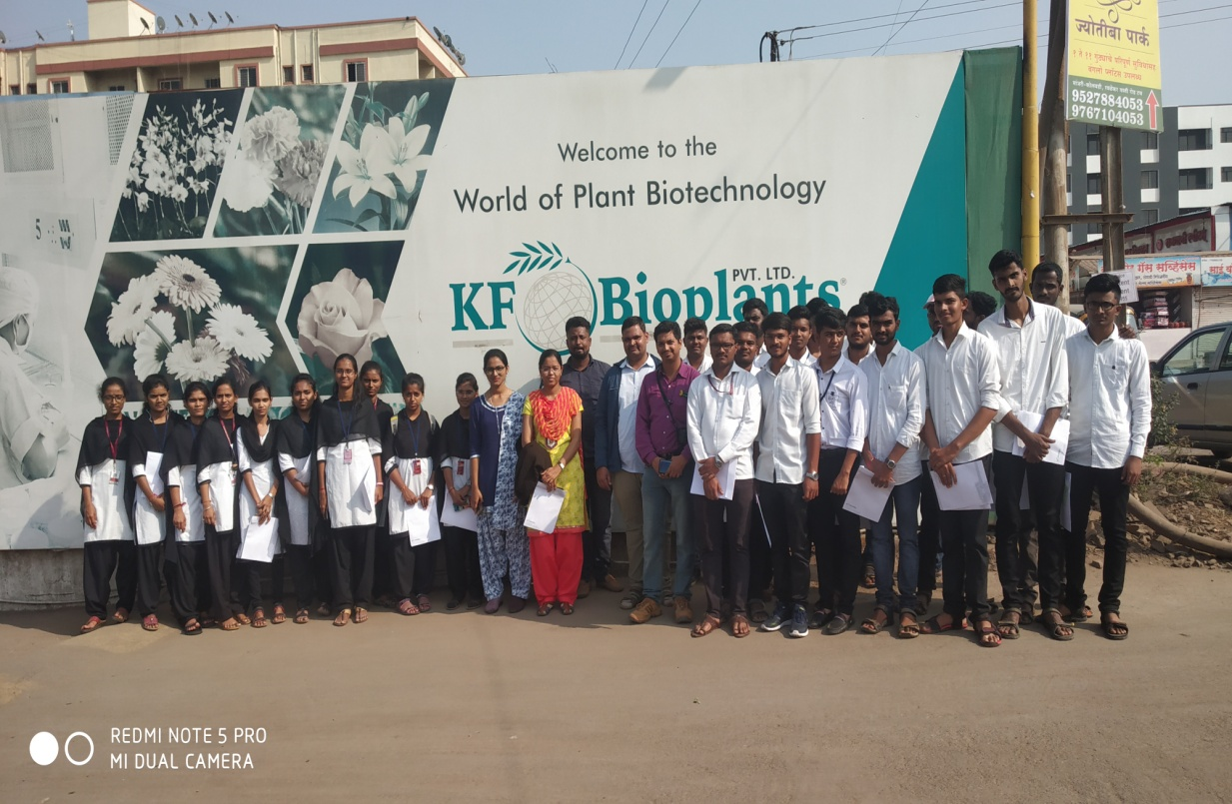
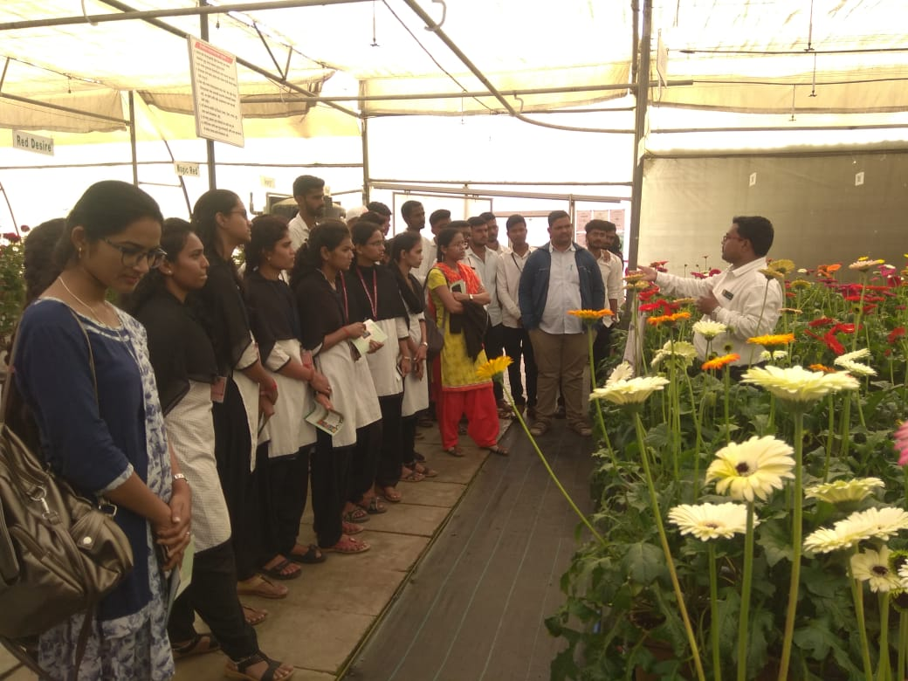
ANNUAL REPORT: STUDENTS EXPOSURE VISIT
2019-20
Photo 1: Visit to KF Bio-plants Pvt. Ltd. Manjari Bk. Pune
Photo 2: Visit to KF Bio-plants Pvt. Ltd demo plot

Slide 29
ANNUAL REPORT: STUDENTS EXPOSURE VISIT
2019-20
12. Visit to Commercial vegetable production plot, vadgoan
Course No. | : | ALE HORT-486
Course Teacher | : | Mr. N. S. Patil
Course Title | : | Vegetable production
Purpose of visit | : | Getting extra knowledge about commercial vegetable production of different vegetables crops
Place of visit | : | Vadgoan
Class of students | : | B.Sc. Agriculture 4th Year ( Sem.-VIII)
No. of Students | : | 15
Spots Visited | : | Commercial vegetable production plot of Mr. Machhindra Kumbhar, vadgoan
Staff Accompanied |  | -
Date of visit | : | 21st February 2020

Slide 30
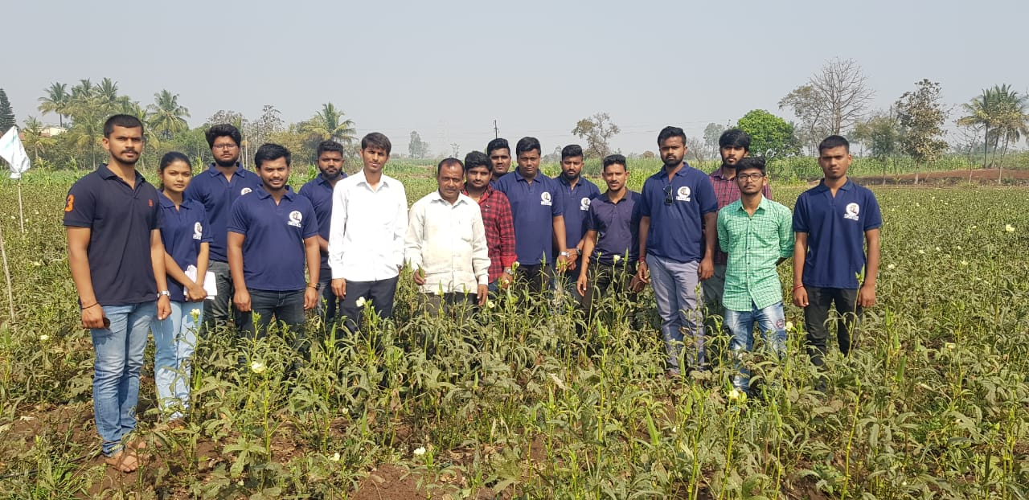
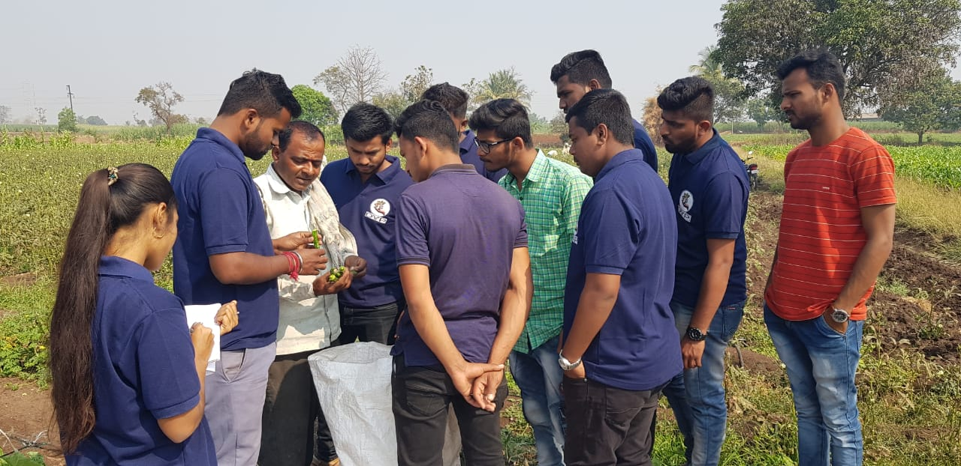
ANNUAL REPORT: STUDENTS EXPOSURE VISIT
2019-20
Photo 1: Visit to commercial okra vegetable crop
Photo 2: Mr. Machhindra Kumbhar giving information about okra crop.

Slide 31
ANNUAL REPORT: STUDENTS EXPOSURE VISIT
2019-20
13. Visit to “Sphurti Dairy Processing Unit, Gokul Shirgaon
Course No. | : | ASDS-487
Course Teacher | : | Dr. A. S. Mukhekar
Course Title | : | Milk and Milk Products
Purpose of visit | : | To get knowledge about dairy unit
Place of visit | : | Gokul Shirgaon
Class of students | : | SEM- VIII, Final Year B.Sc. Agri
No. of Students | : | 14
Spots Visited | : | Mehta Dairies (Kolhapur)
Staff Accompanied |  | -
Date of visit | : | 22-02-2020

Slide 32
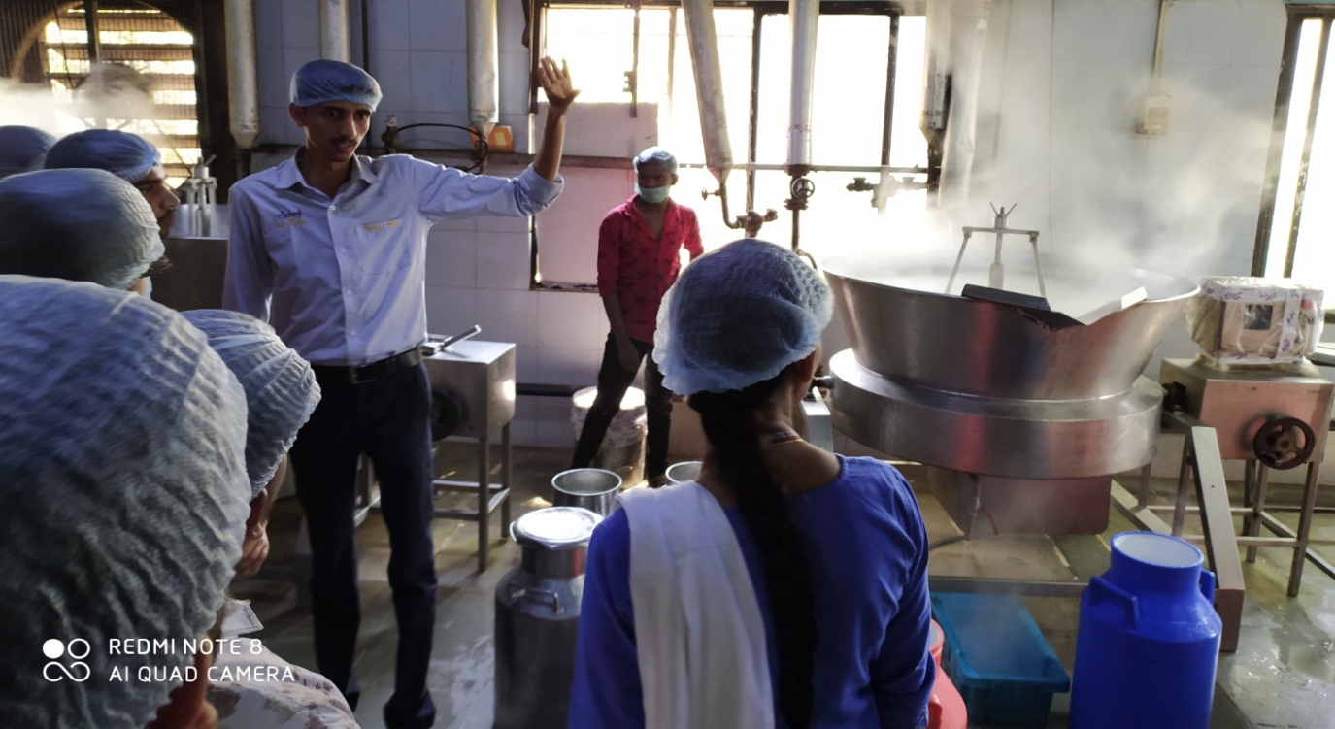
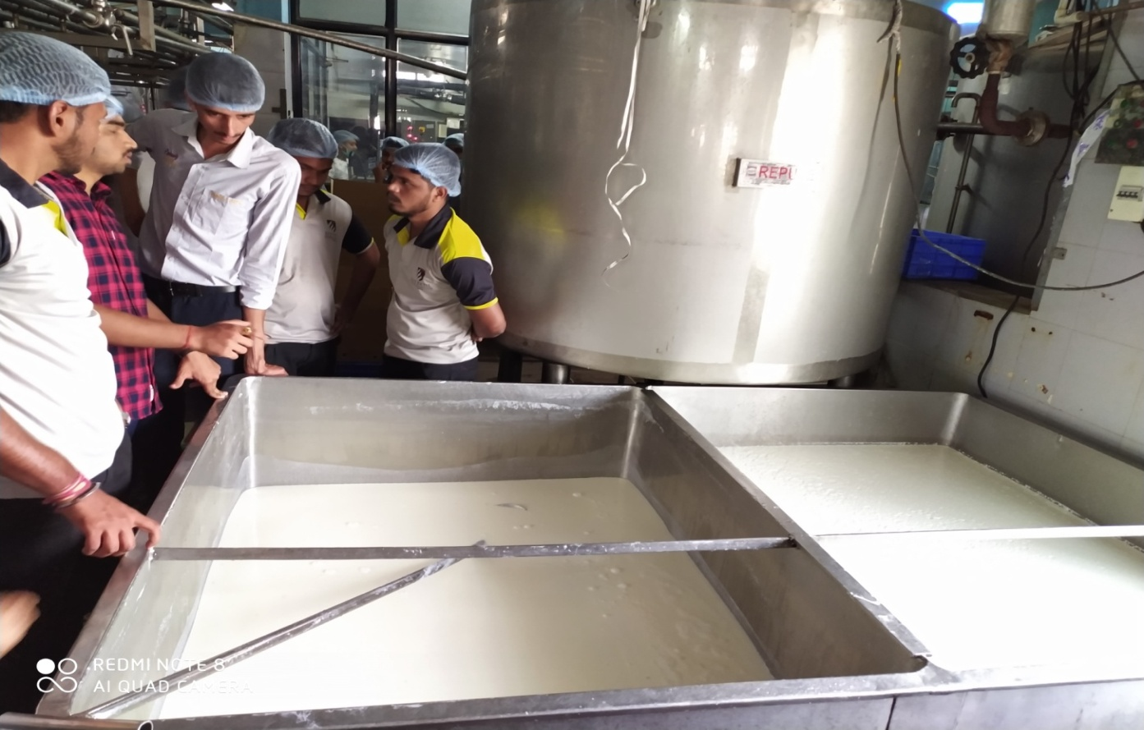
ANNUAL REPORT: STUDENTS EXPOSURE VISIT
2019-20
Photo 1: Basundi Preparation Sphurti Dairy Processing Unit, Gokul Shirgaon
Photo 2: Lassi Preparation Sphurti Dairy Processing Unit, Gokul Shirgaon

Slide 33
ANNUAL REPORT: STUDENTS EXPOSURE VISIT
2019-20
14. Visit to Organic Farming at Kaneri math, Kaneri
Course No. | : | ALE-SSAC-486
Course Teacher | : | Prof .A .P. Gaikwad
Course Title | : | Soil and water clinic
Purpose of visit | : | 1. To know about different types and manure used in organic farming and procedure of their preparation. 2. To know the procedure for getting the organic farming certificate
Place of visit | : | Kaneri
Class of students | : | IV year Students (VIII sem. )
No. of Students | : | 21
Spots Visited | : | Kaneri math, Kolhapur
Staff Accompanied |  | -
Date of visit | : | 05 March 2020

Slide 34
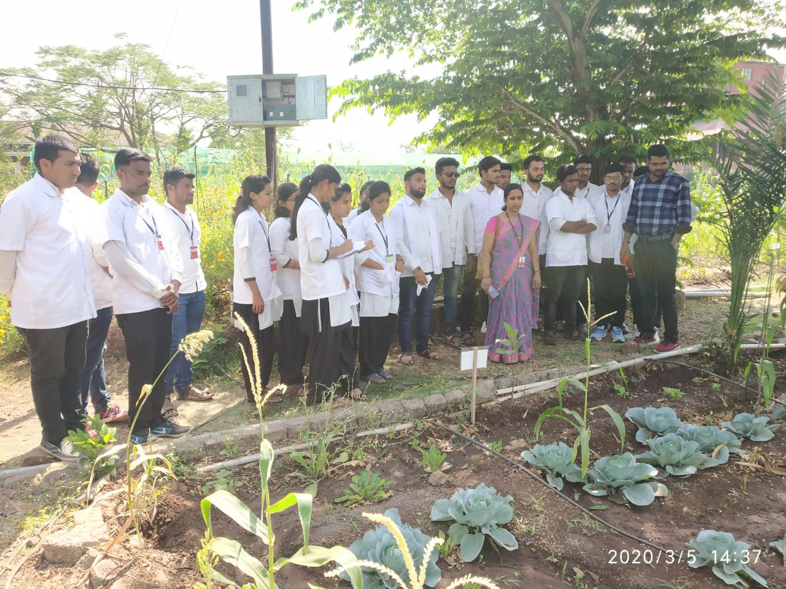
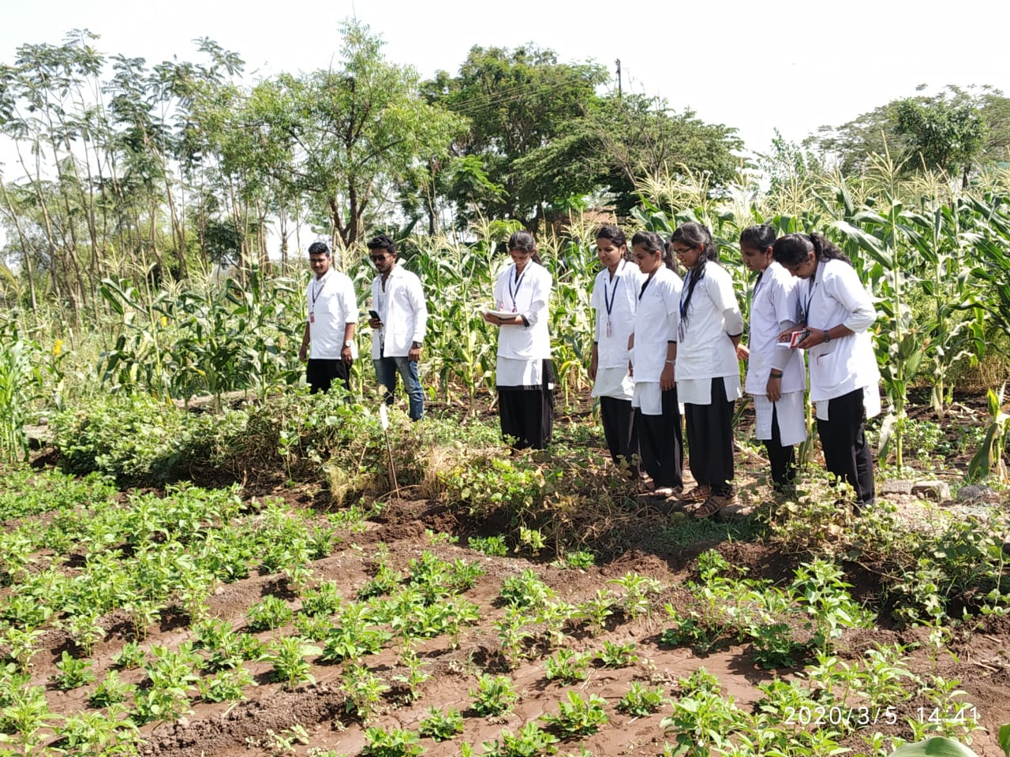
ANNUAL REPORT: STUDENTS EXPOSURE VISIT
2019-20
Photo 1: Organic farming plot Information given by Mr. Somnath Gadade ,Farm Manager, Kaneri Math
Photo 2: Visit to Organic Farm of Shri Siddhgiri Sansthan at Kaneri Math

Slide 35
ANNUAL REPORT: STUDENTS EXPOSURE VISIT
2019-20
15. Soil Testing Laboratory at College of Agriculture, Kolhapur
Course No. | : | ALE-SSAC-486
Course Teacher | : | Prof .A .P. Gaikwad
Course Title | : | Soil and water clinic
Purpose of visit | : | To know about the working of soil and water testing laboratory
Place of visit | : | Kolhapur
Class of students | : | IV year Students (VIII sem. )
No. of Students | : | 21
Spots Visited | : | Soil testing lab college of agriculture Kolhapur
Staff Accompanied |  | -
Date of visit | : | 05 March 2020

Slide 36
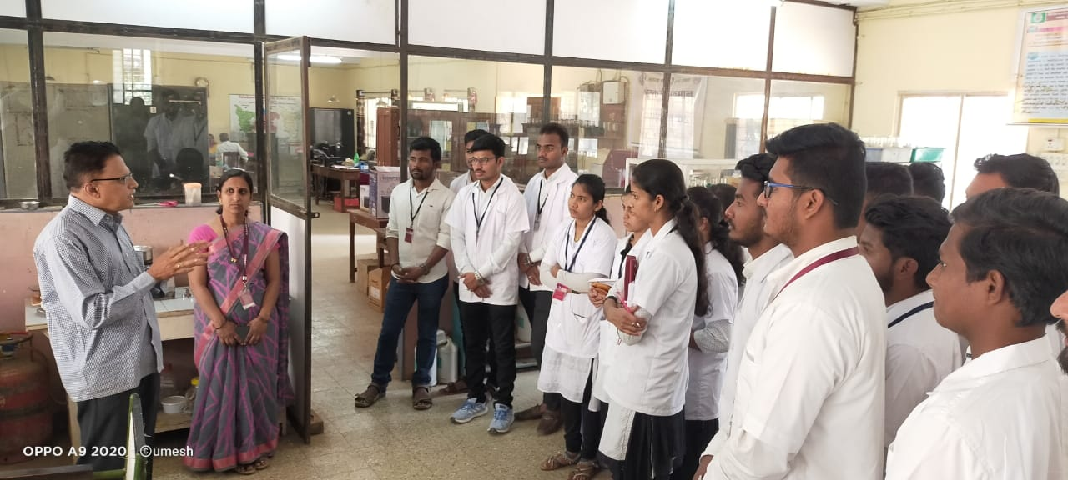
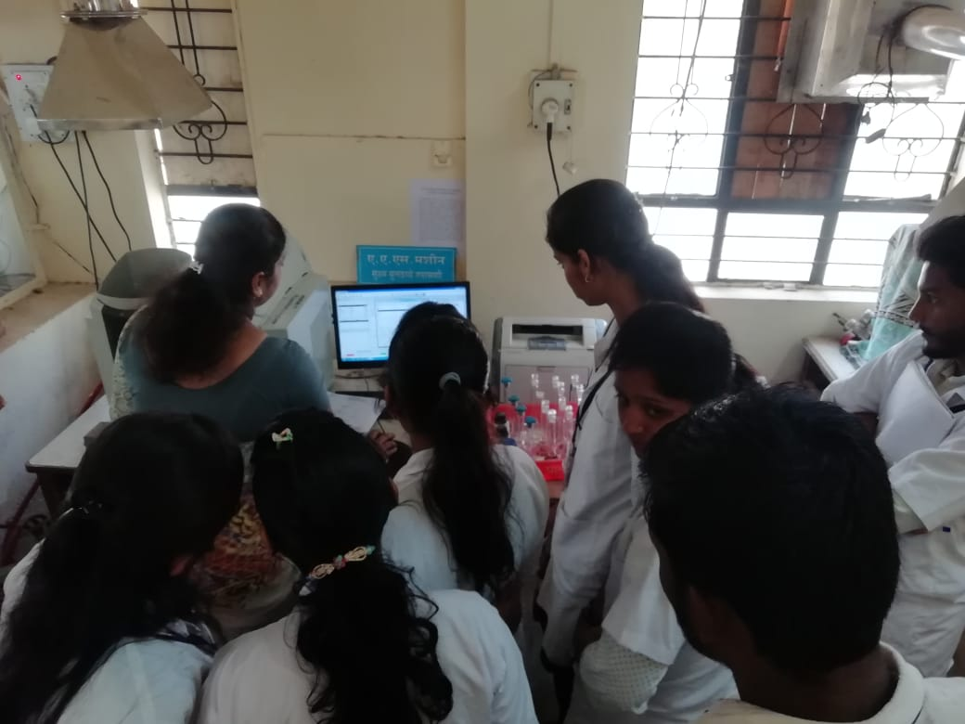
ANNUAL REPORT: STUDENTS EXPOSURE VISIT
2019-20
Photo 1: Prof. M. V. Latkar giving information about soil testing laboratory, College of agriculture, Kolhapur
Photo 2: Demonstration of Kjeldahl’s unit, College of agriculture, Kolhapur

Slide 37
ANNUAL REPORT: STUDENTS EXPOSURE VISIT
2019-20
Summary of Students Exposure Visit 2019-20
In-charge Exposure Academics Incharge Principal Visit
Sr. No. | Semester | No. of Visits
1 | I | 00
2 | II | 01
3 | III | 00
4 | IV | 03
5 | V | 05
6 | VI | 02
7 | VII | 00
8 | VIII | 04
Total Visits |  | 15

